Slide 1
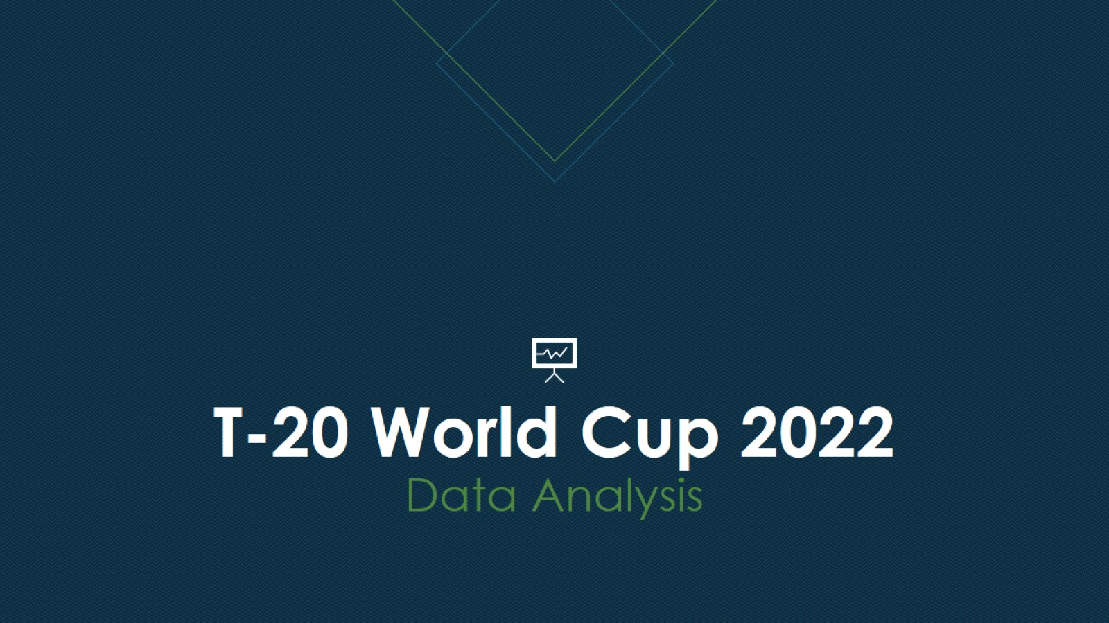
T-20 World Cup 2022 Data Analysis

Slide 2
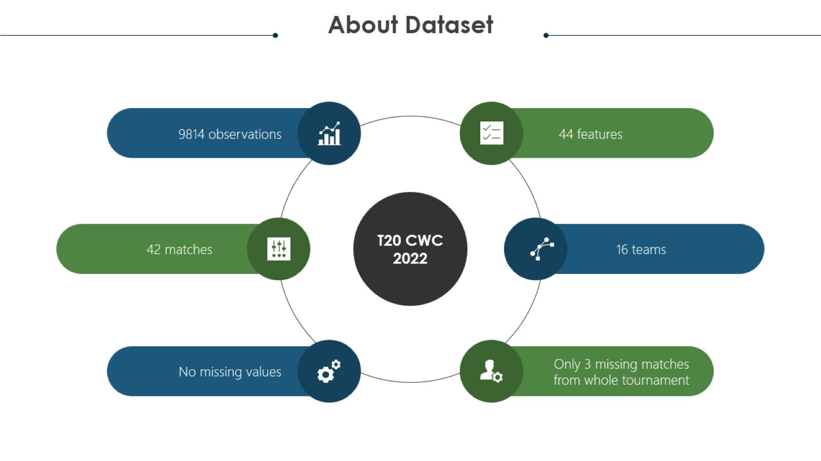
Project analysis slide 2

Slide 3
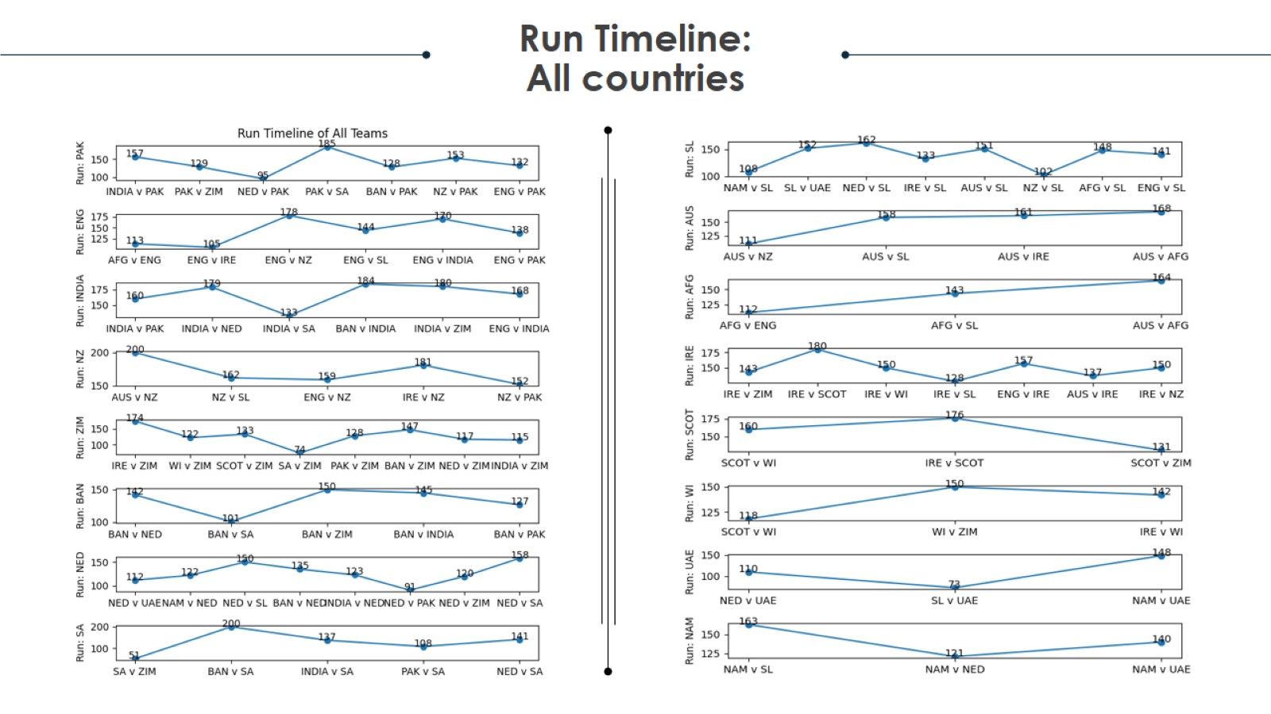
Project analysis slide 2

Slide 4
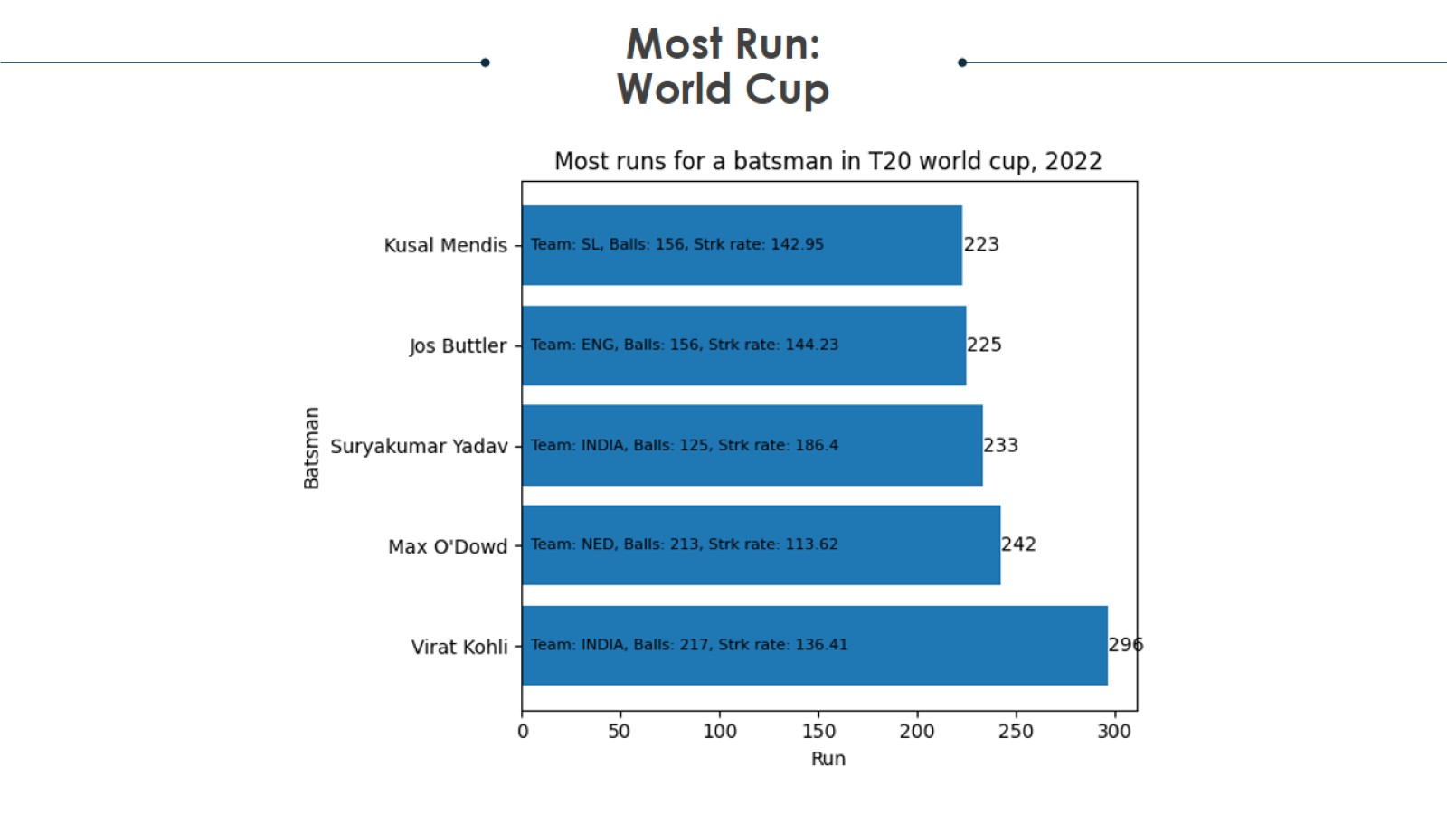
Project analysis slide 2

Slide 5
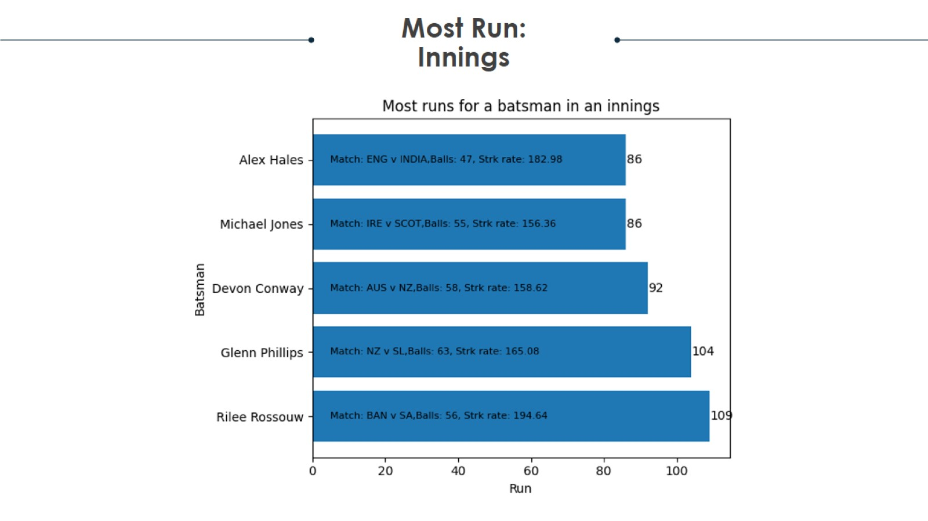
Project analysis slide 2

Slide 6
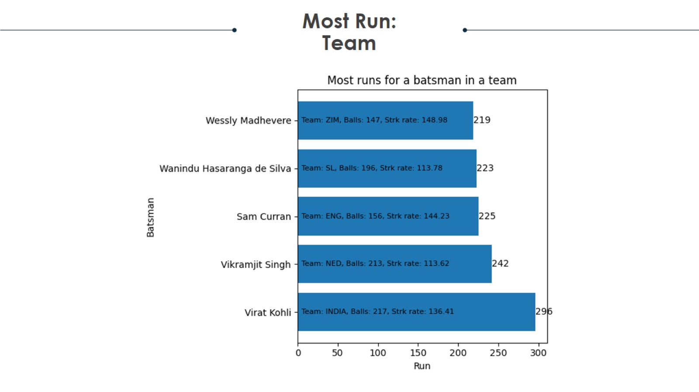
Project analysis slide 2

Slide 7
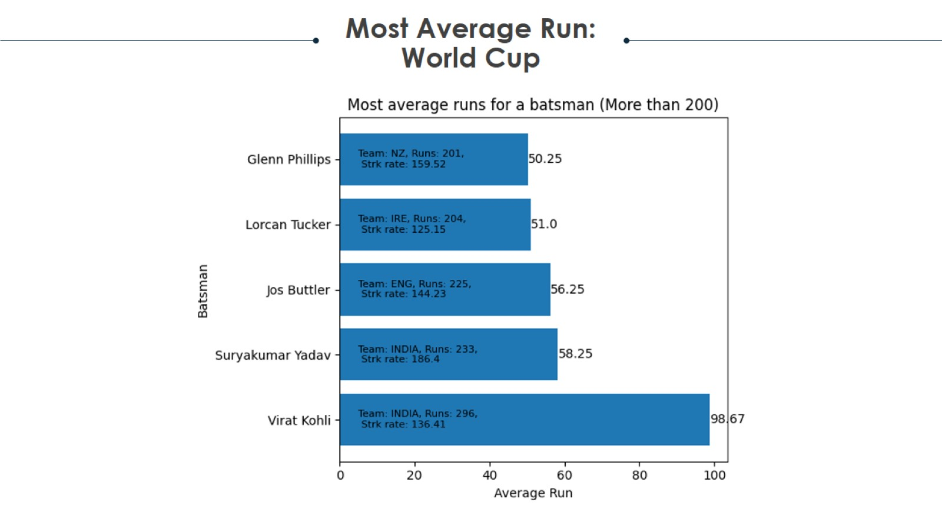
Project analysis slide 2

Slide 8
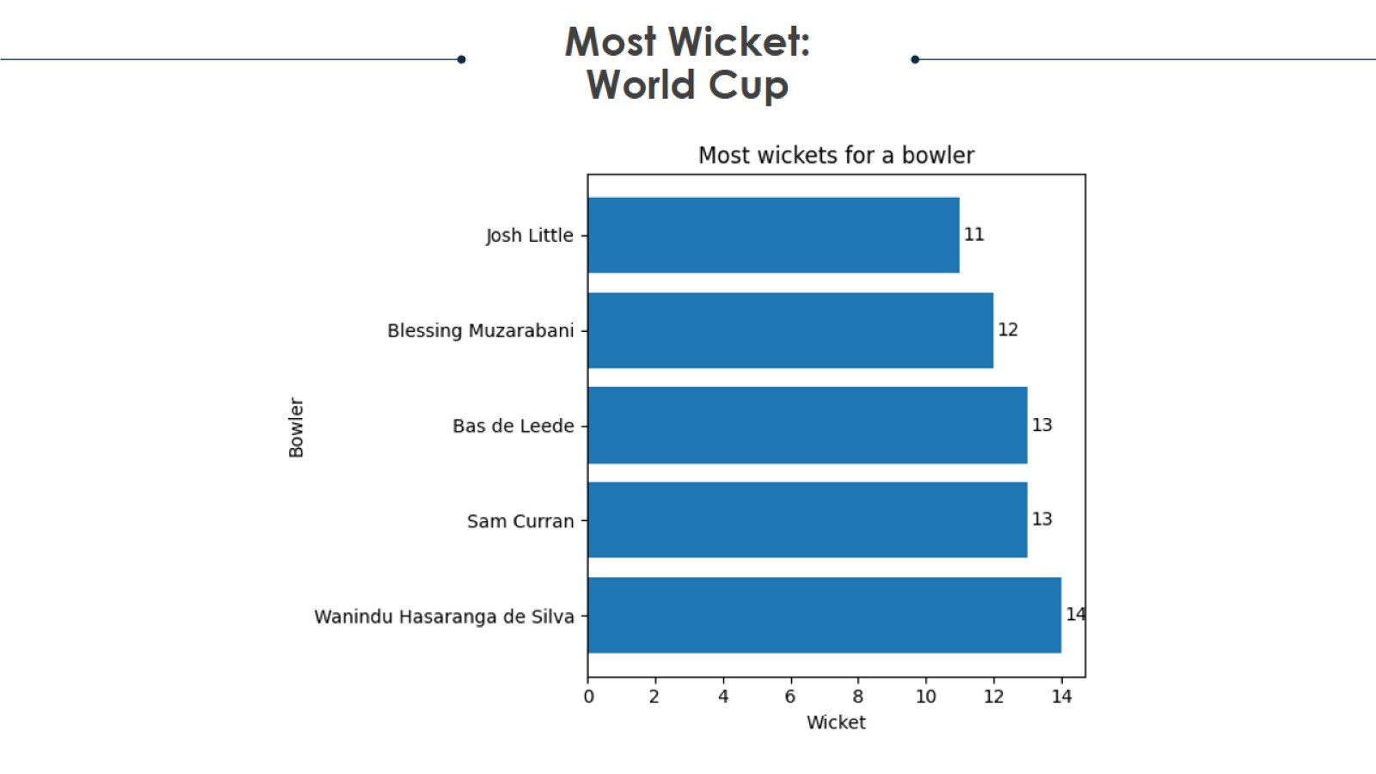
Project analysis slide 2

Slide 9
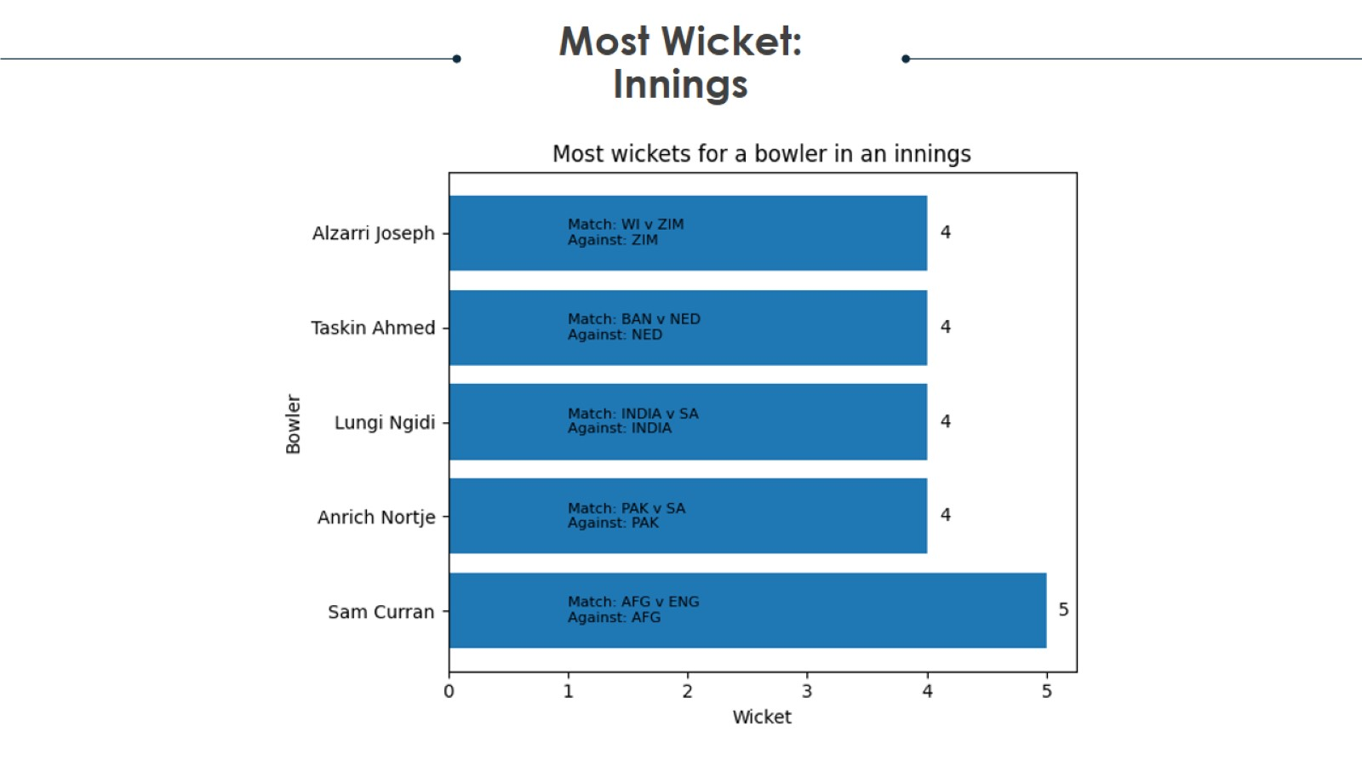
Project analysis slide 2

Slide 10
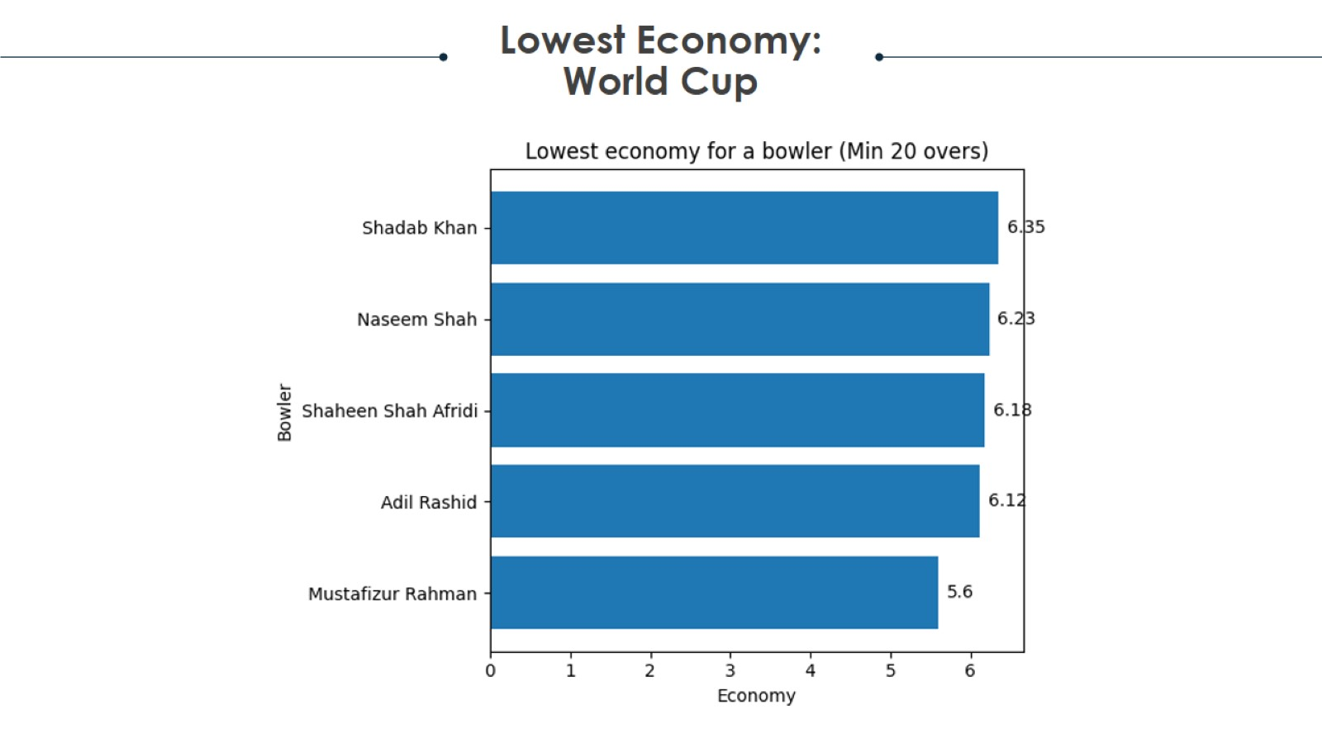
Project analysis slide 2

Slide 11
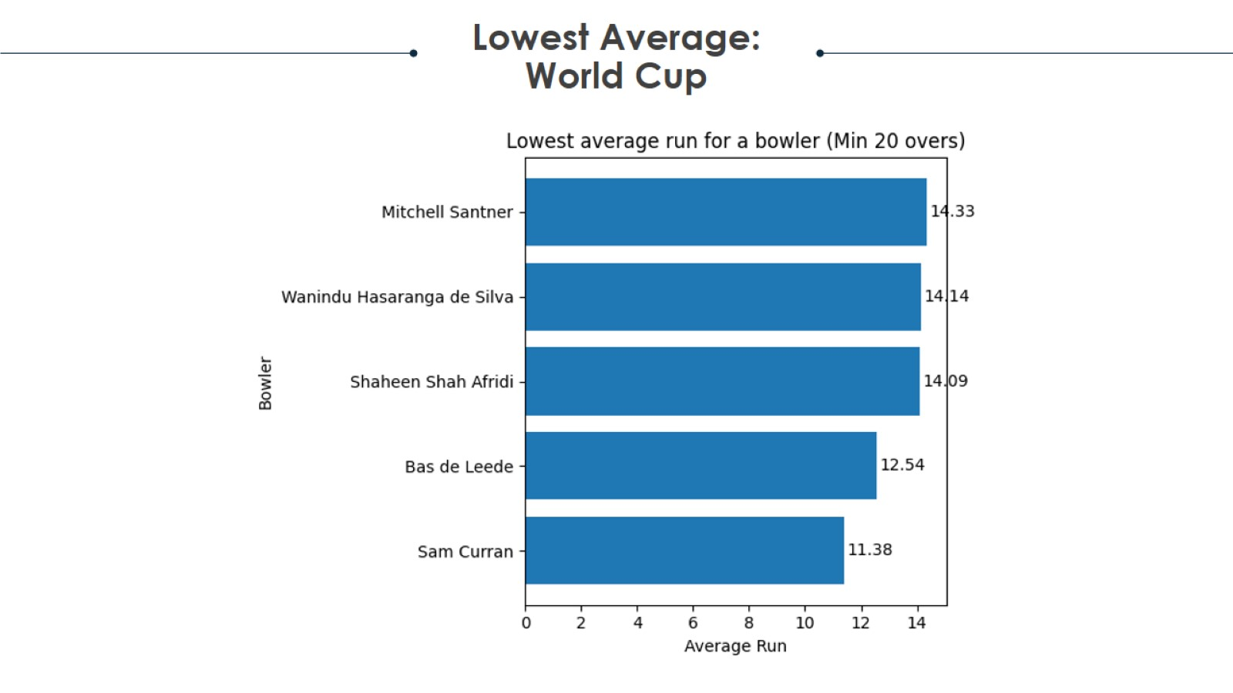
Project analysis slide 2

Slide 12
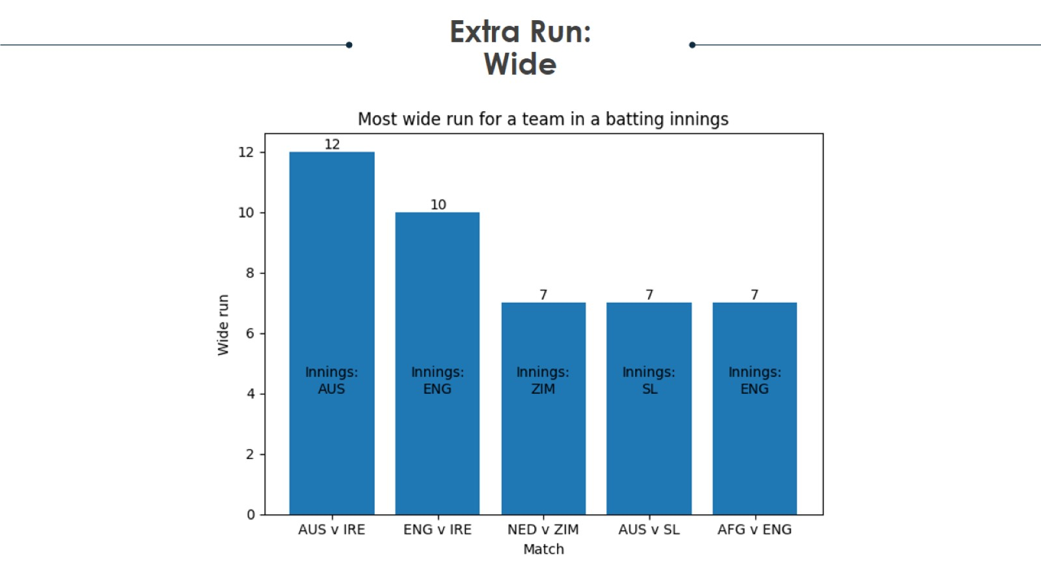
Project analysis slide 2

Slide 13
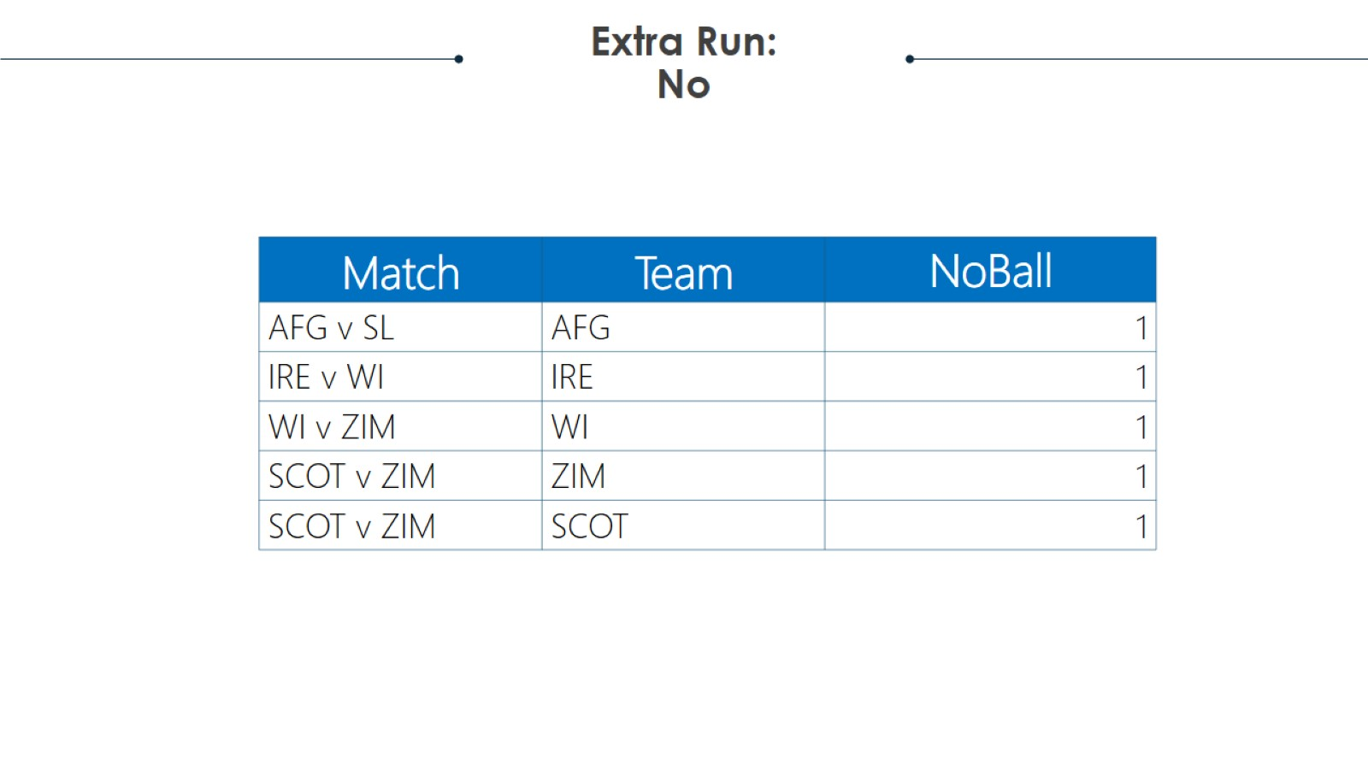
Project analysis slide 2

Slide 14
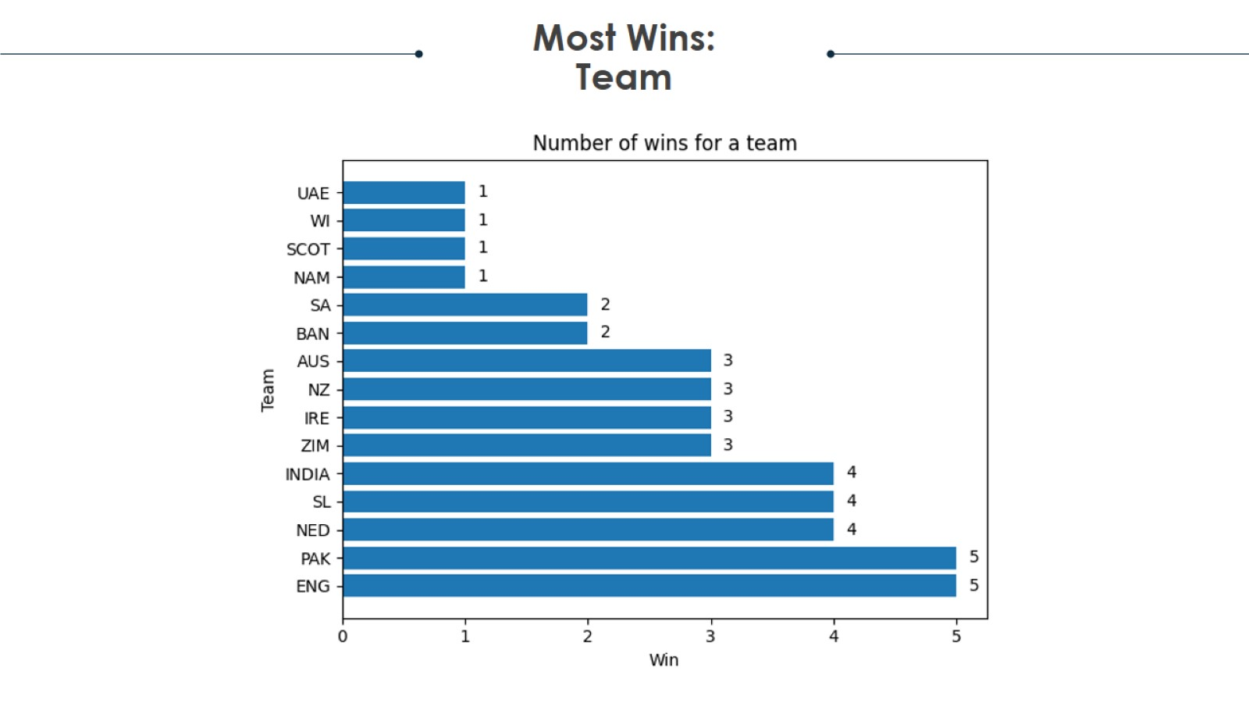
Project analysis slide 2

Slide 15
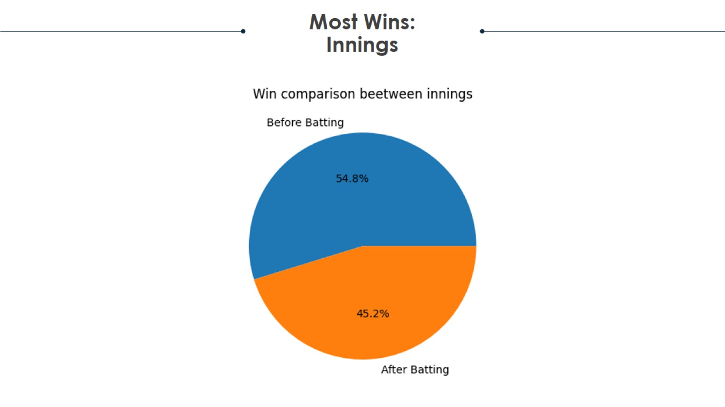
Project analysis slide 2

Slide 16
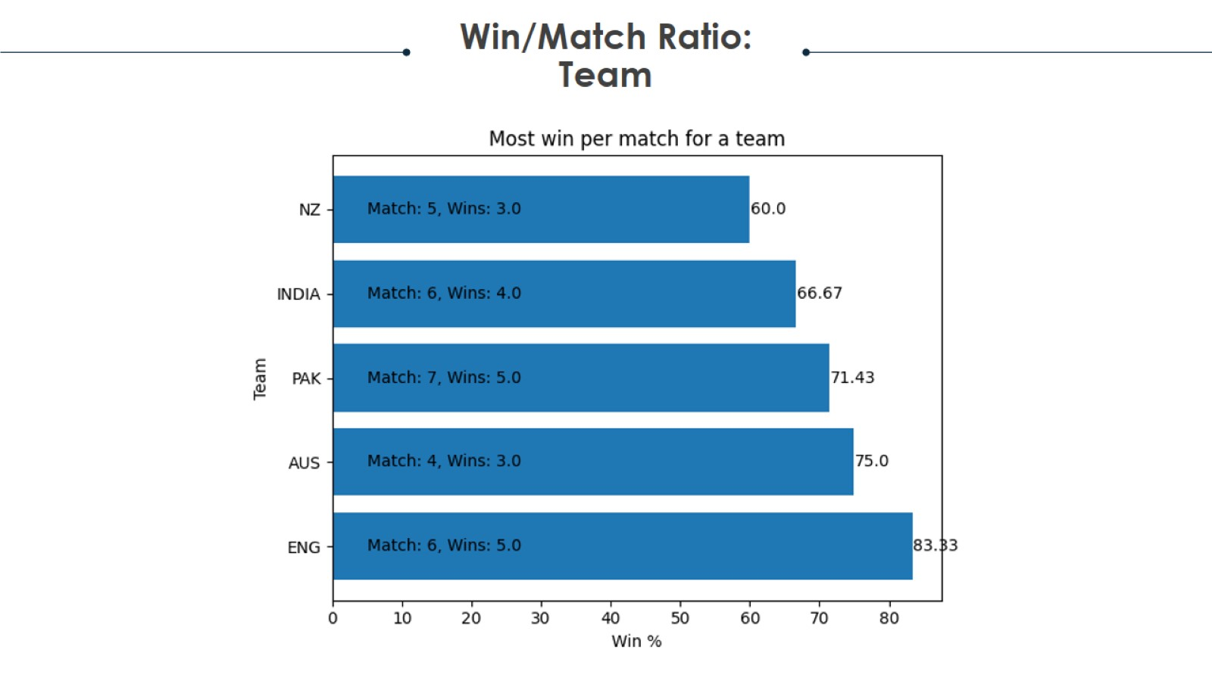
Project analysis slide 2

Slide 17
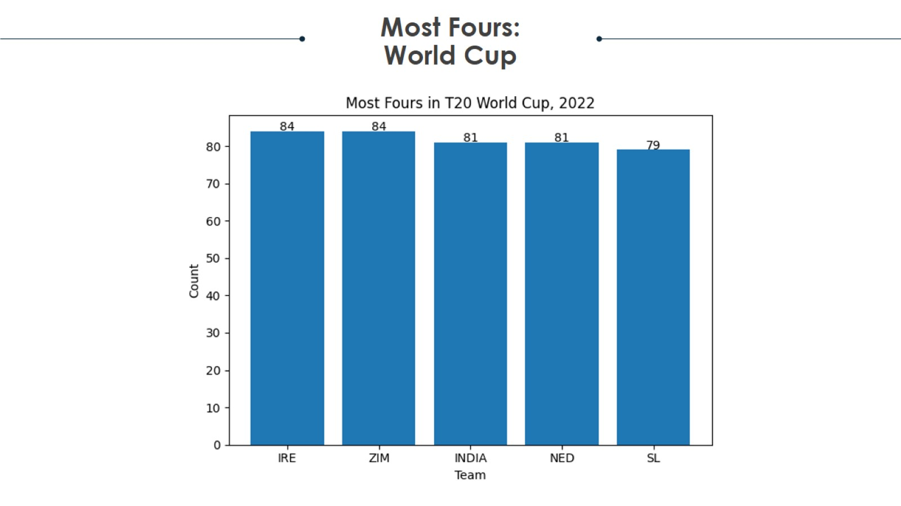
Project analysis slide 2

Slide 18
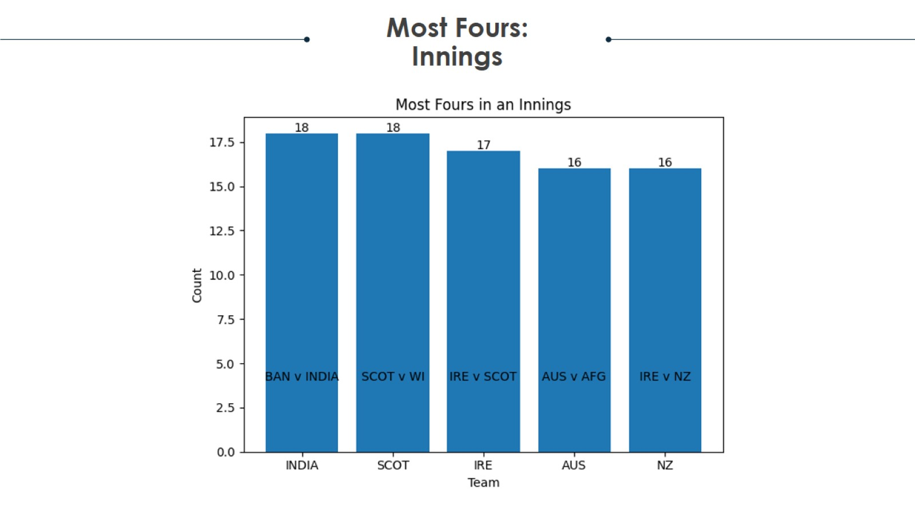
Project analysis slide 2

Slide 19
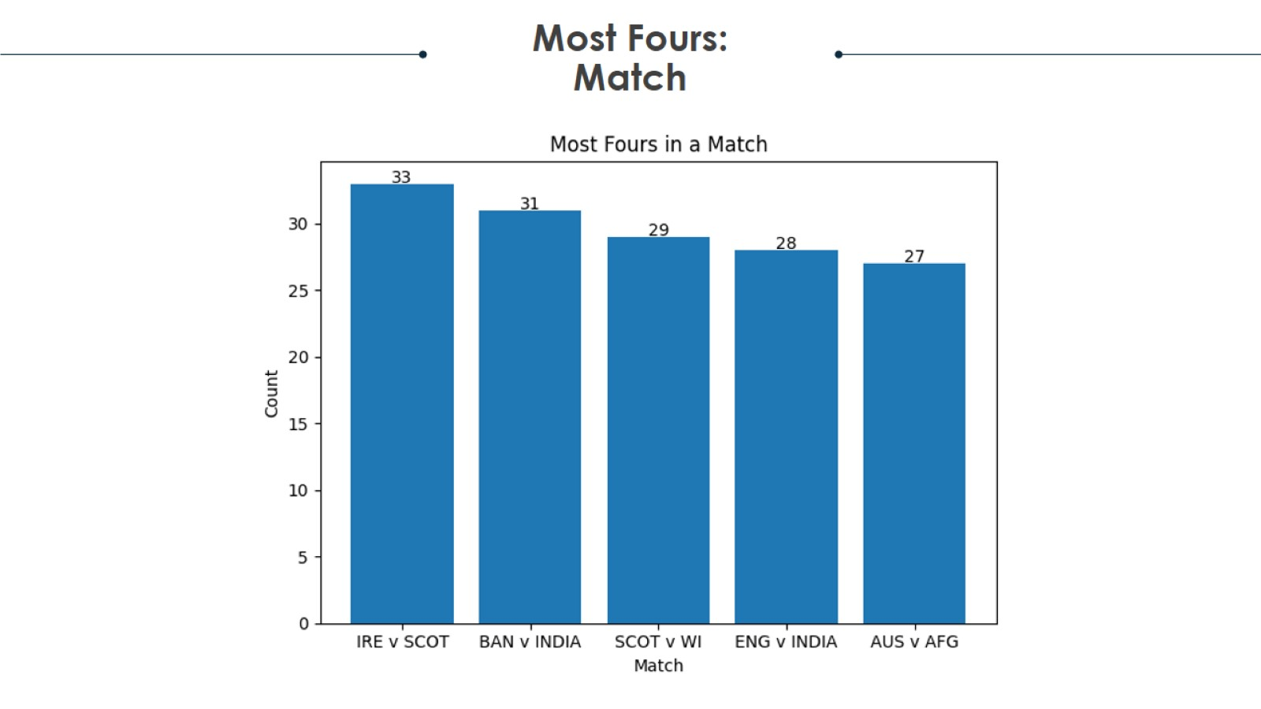
Project analysis slide 2

Slide 20
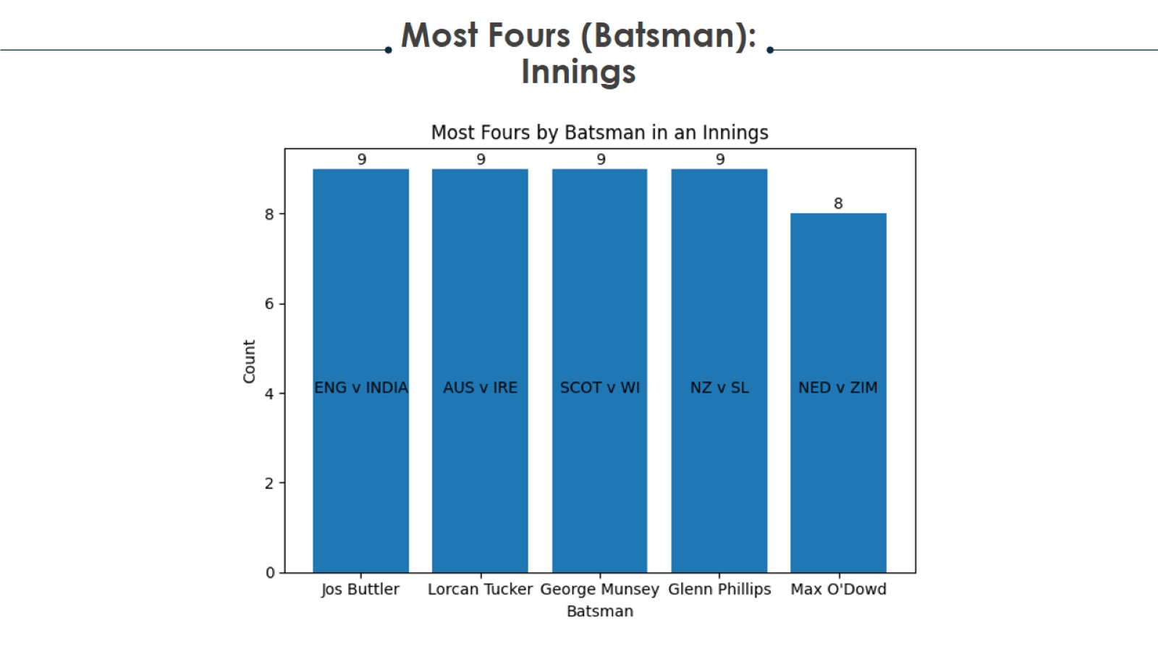
Project analysis slide 2

Slide 21
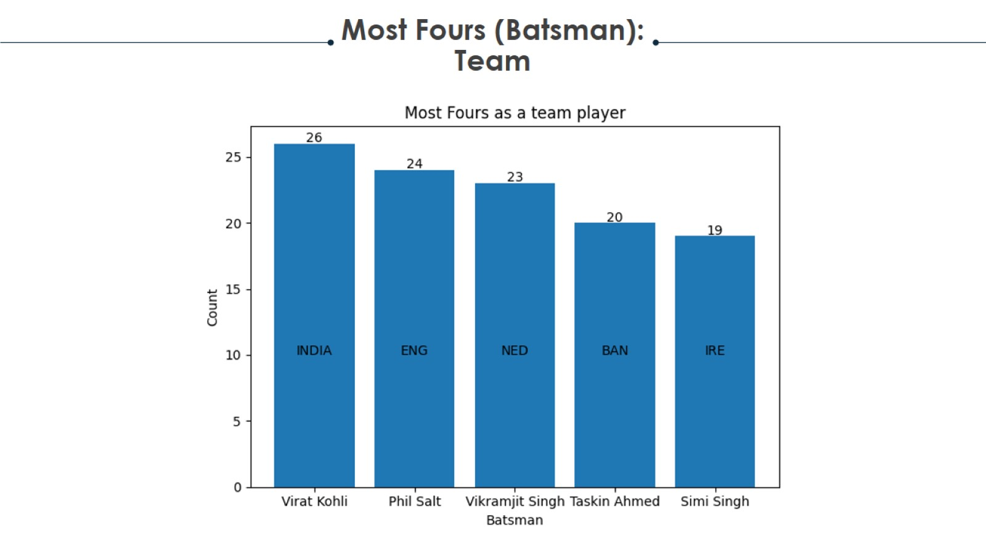
Project analysis slide 2

Slide 22
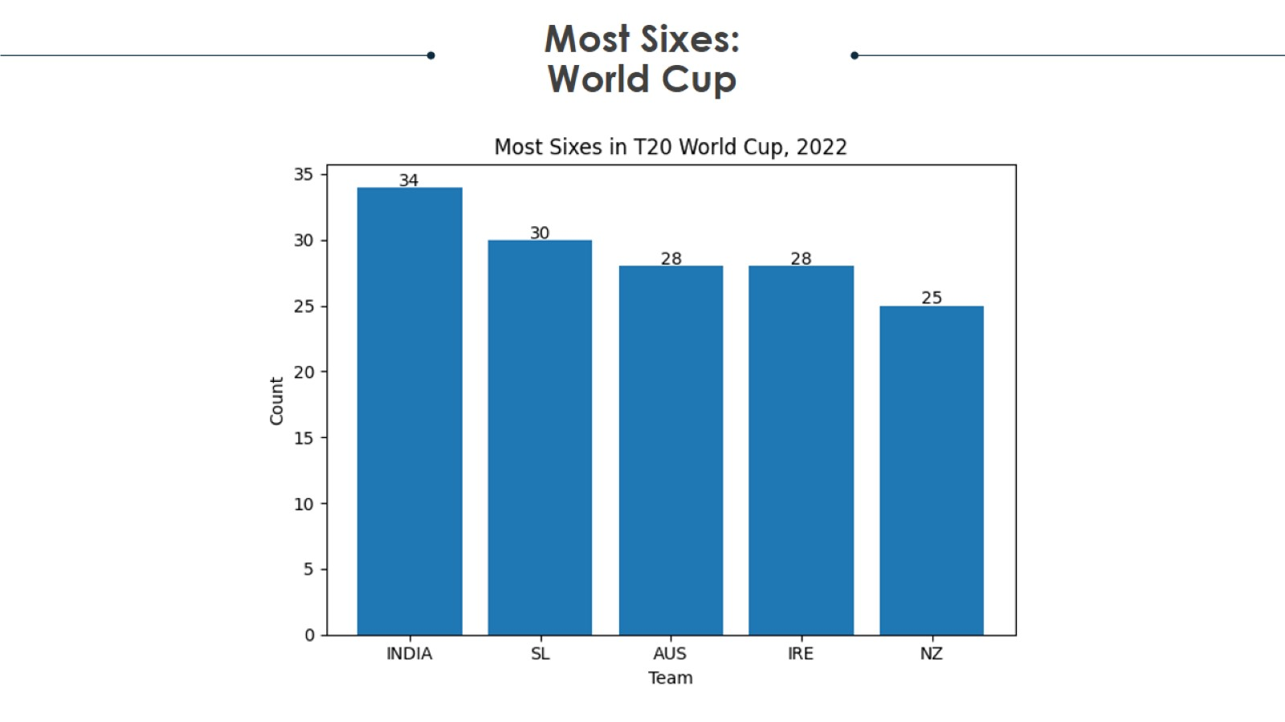
Project analysis slide 2

Slide 23
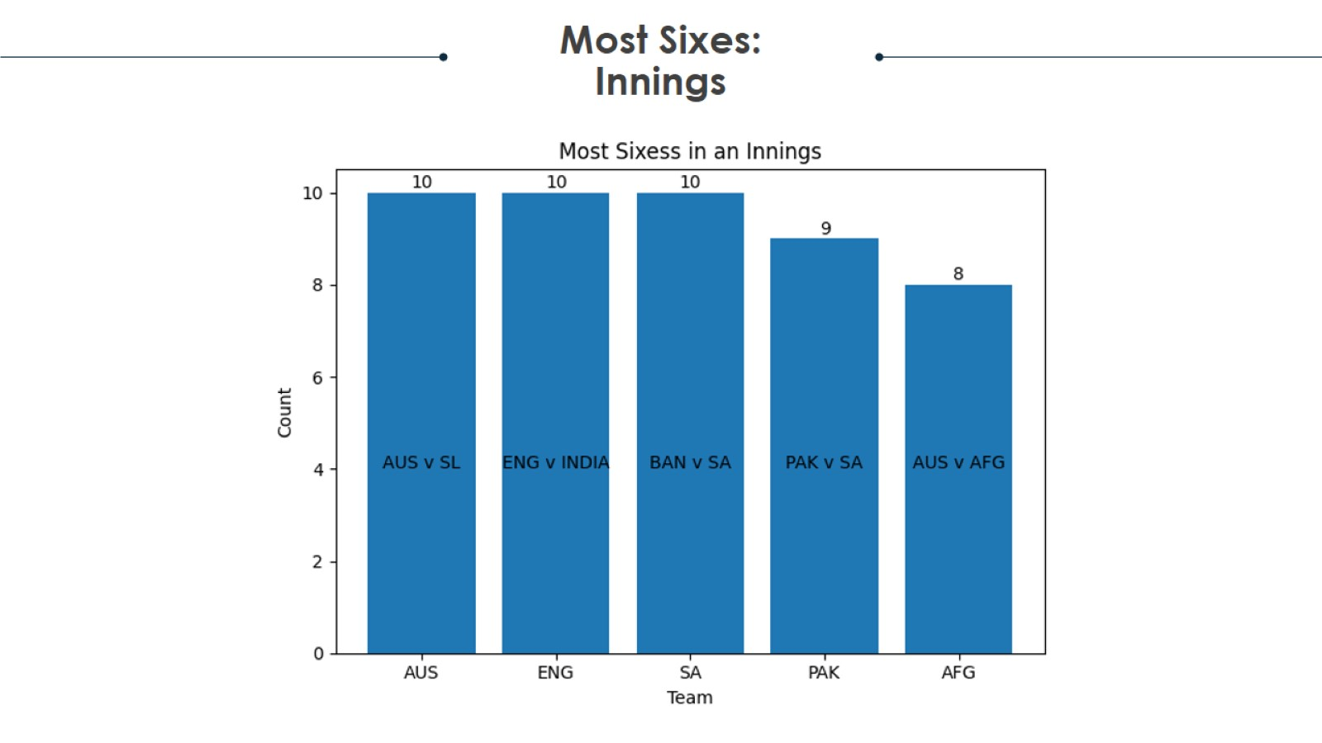
Project analysis slide 2

Slide 24
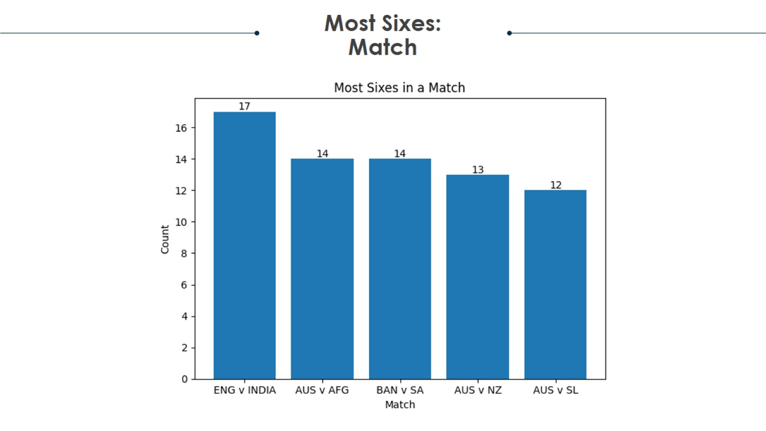
Project analysis slide 2

Slide 25
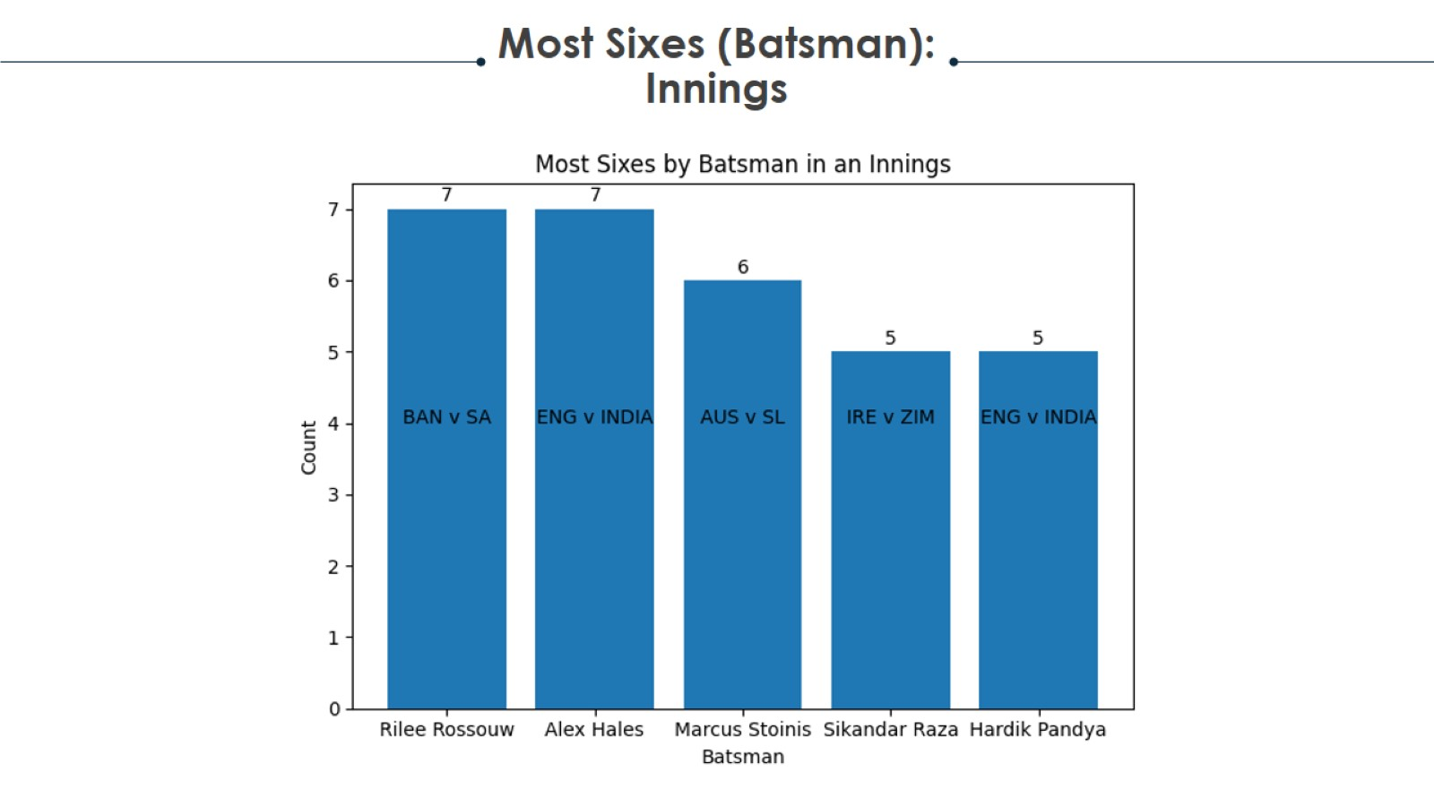
Project analysis slide 2

Slide 26

Project analysis slide 2

Slide 27
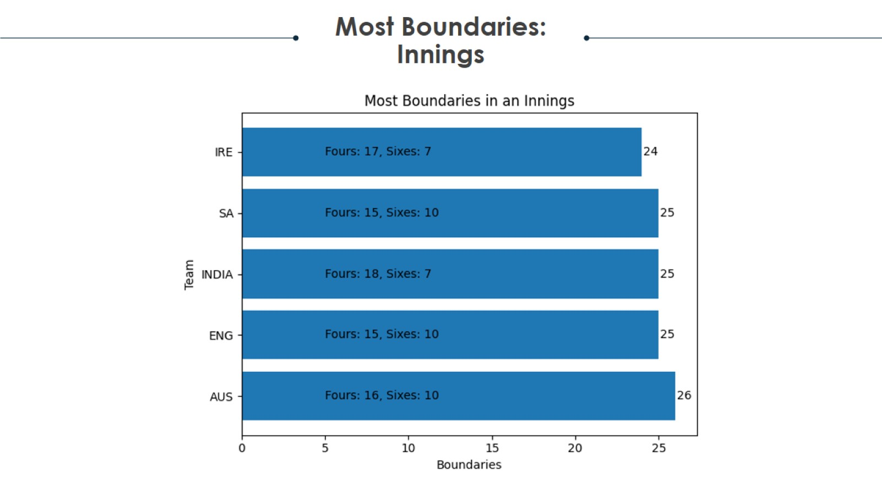
Project analysis slide 2

Slide 28
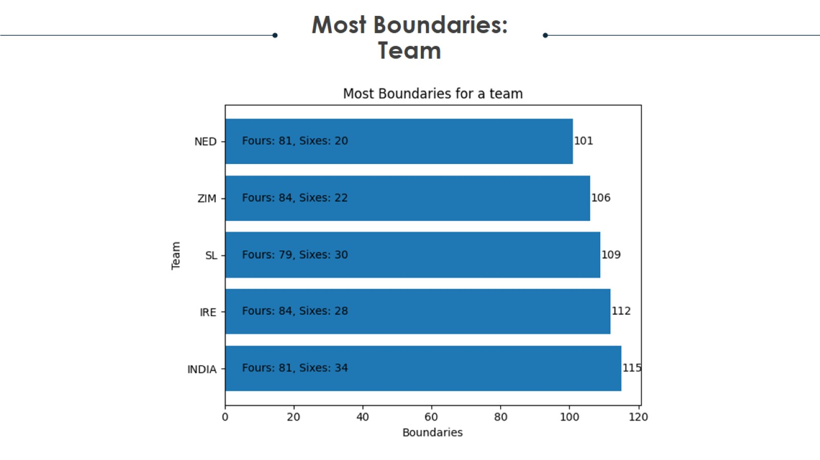
Project analysis slide 2

Slide 29
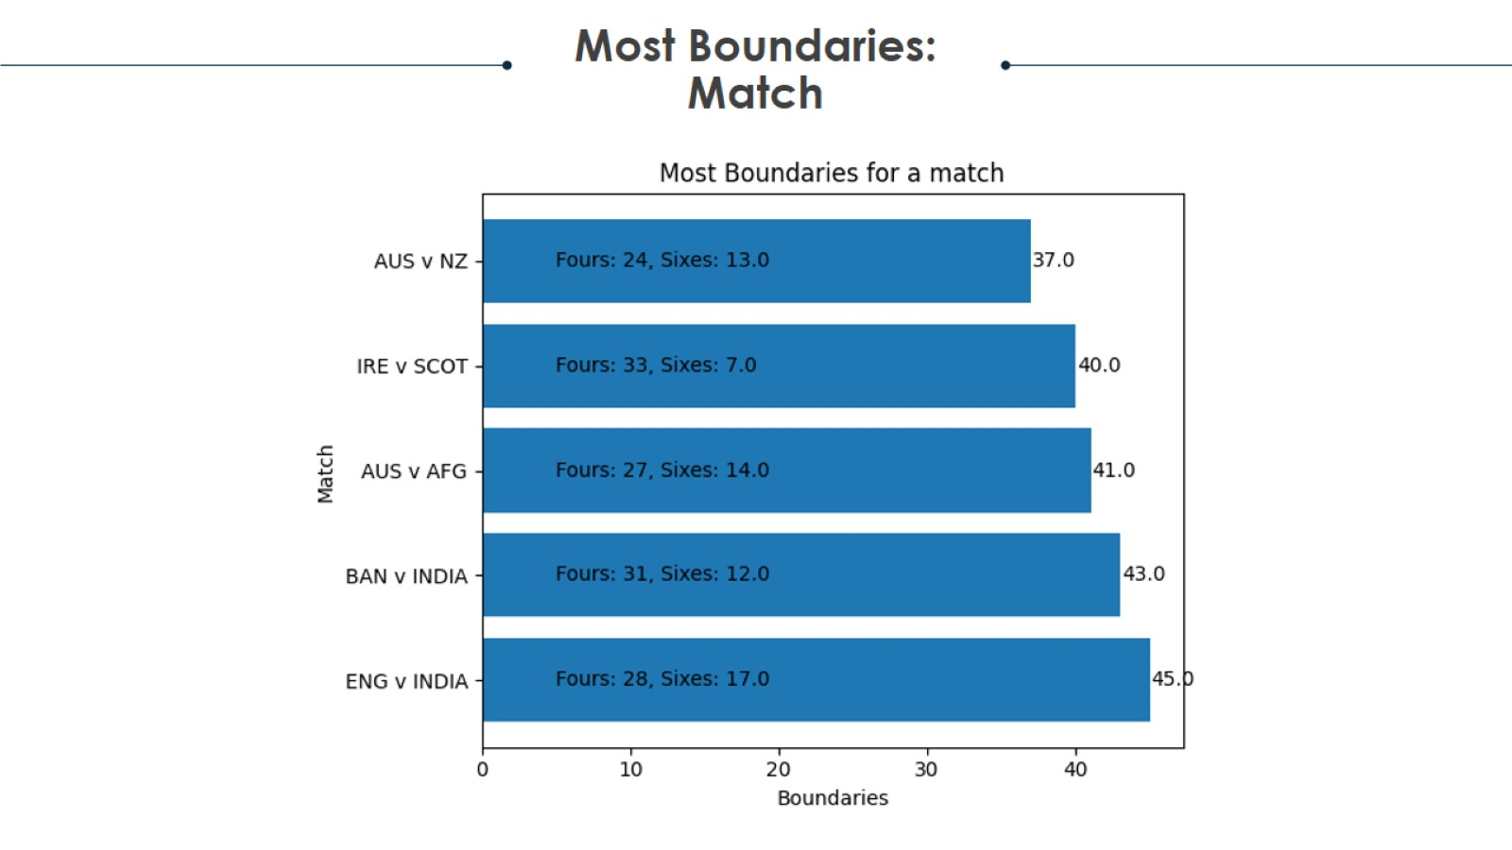
Project analysis slide 2

Slide 30
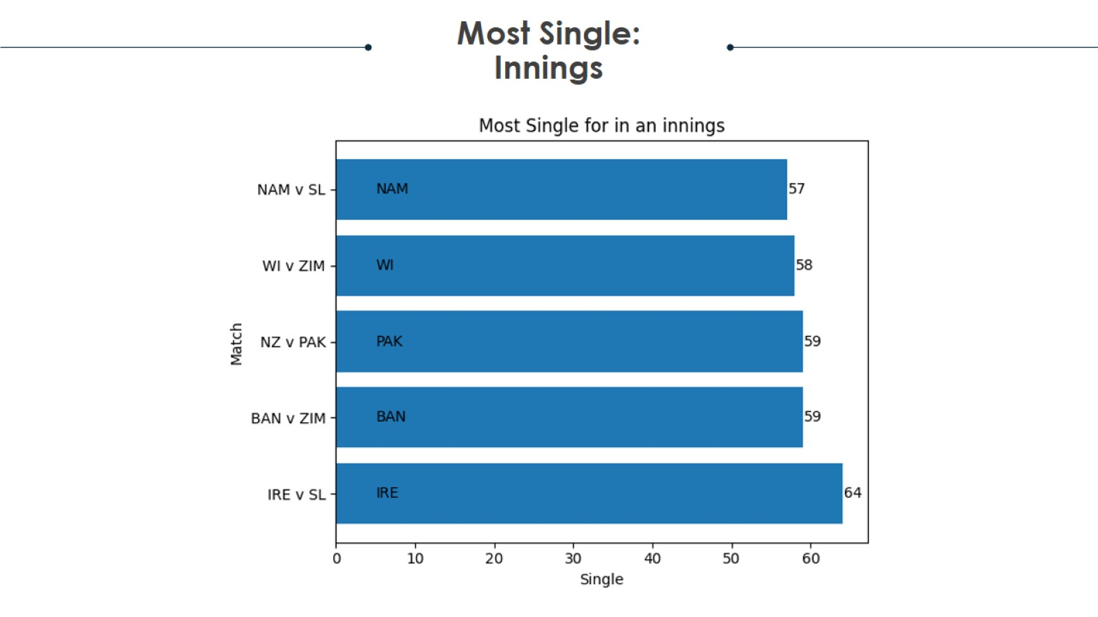
Project analysis slide 2

Slide 31
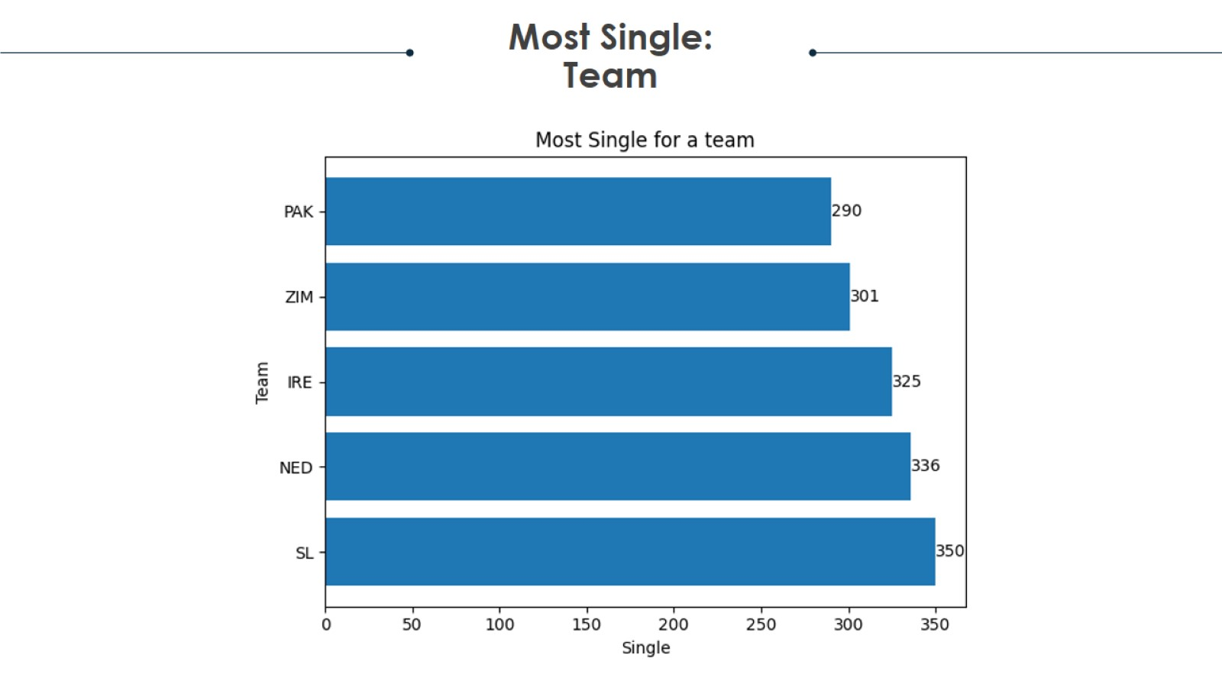
Project analysis slide 2

Slide 32
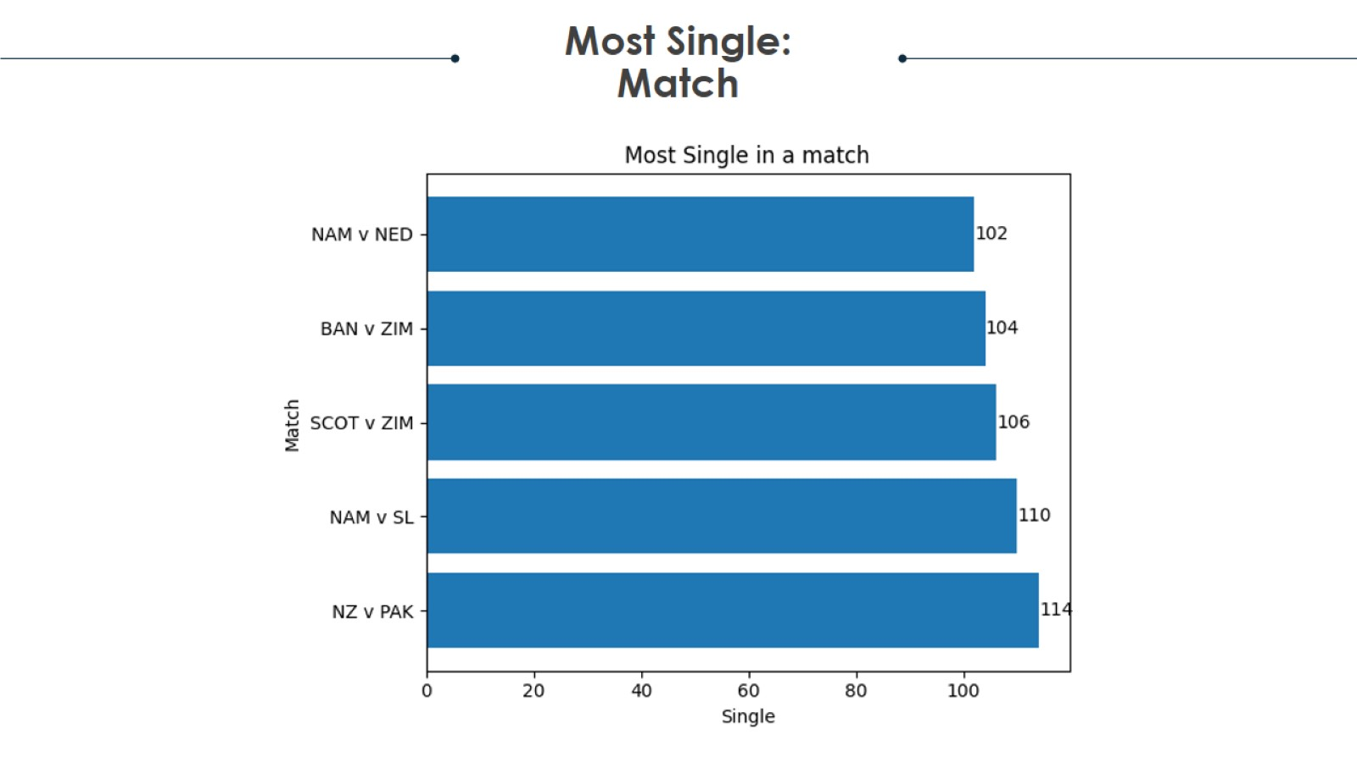
Project analysis slide 2

Slide 33
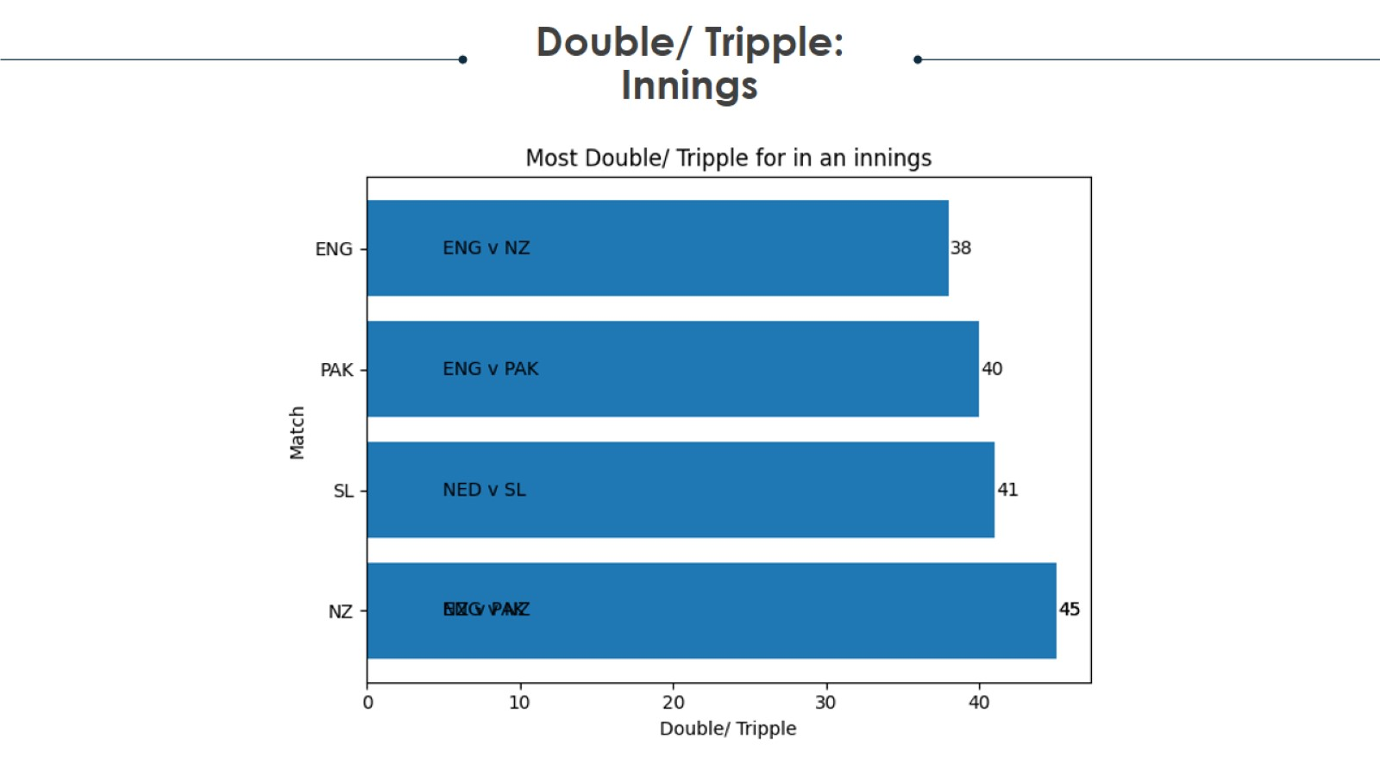
Project analysis slide 2

Slide 34
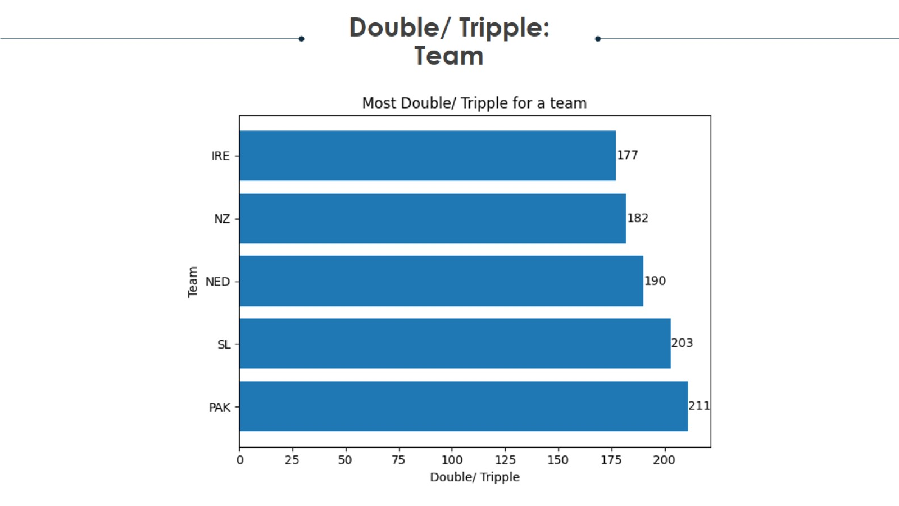
Project analysis slide 2

Slide 35
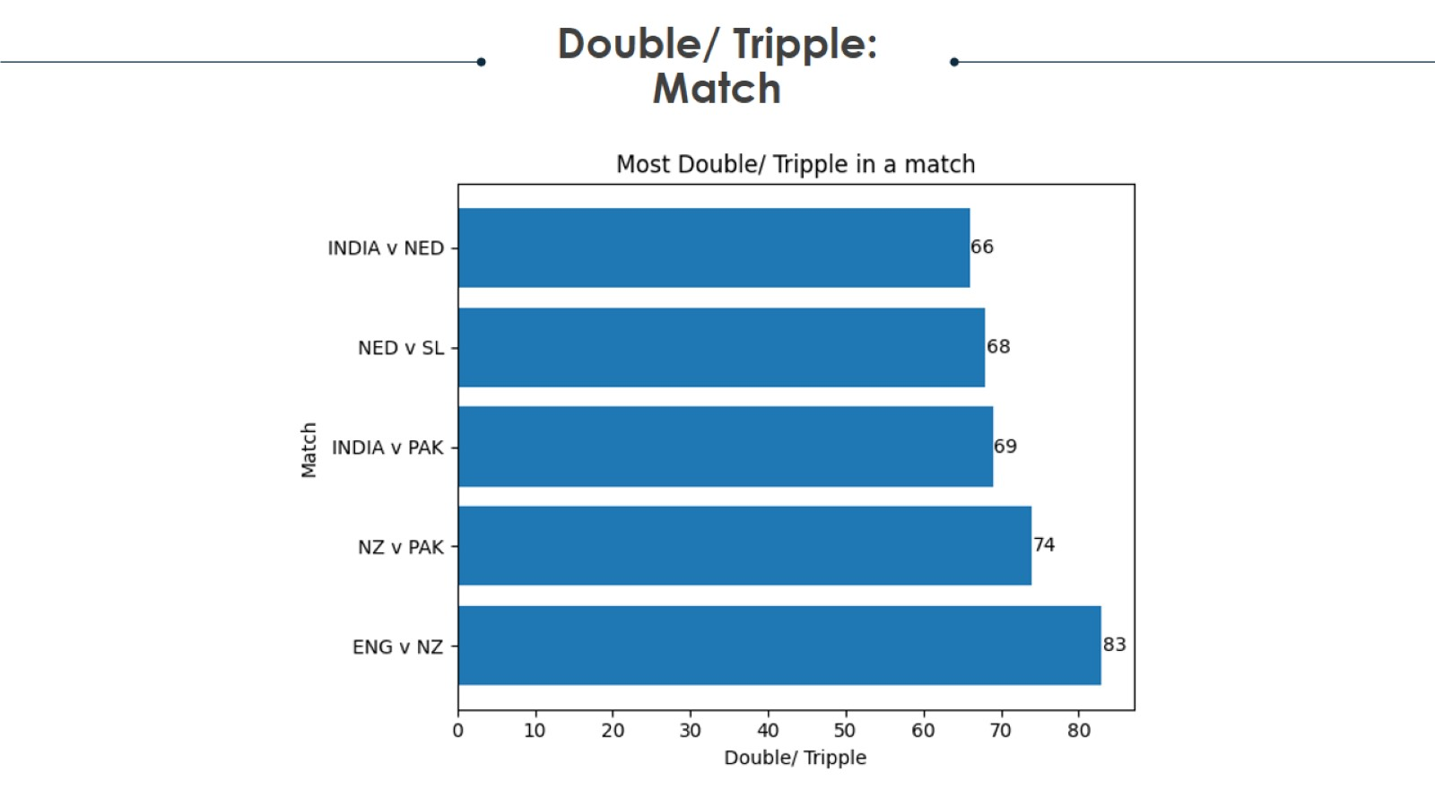
Project analysis slide 2

Slide 36
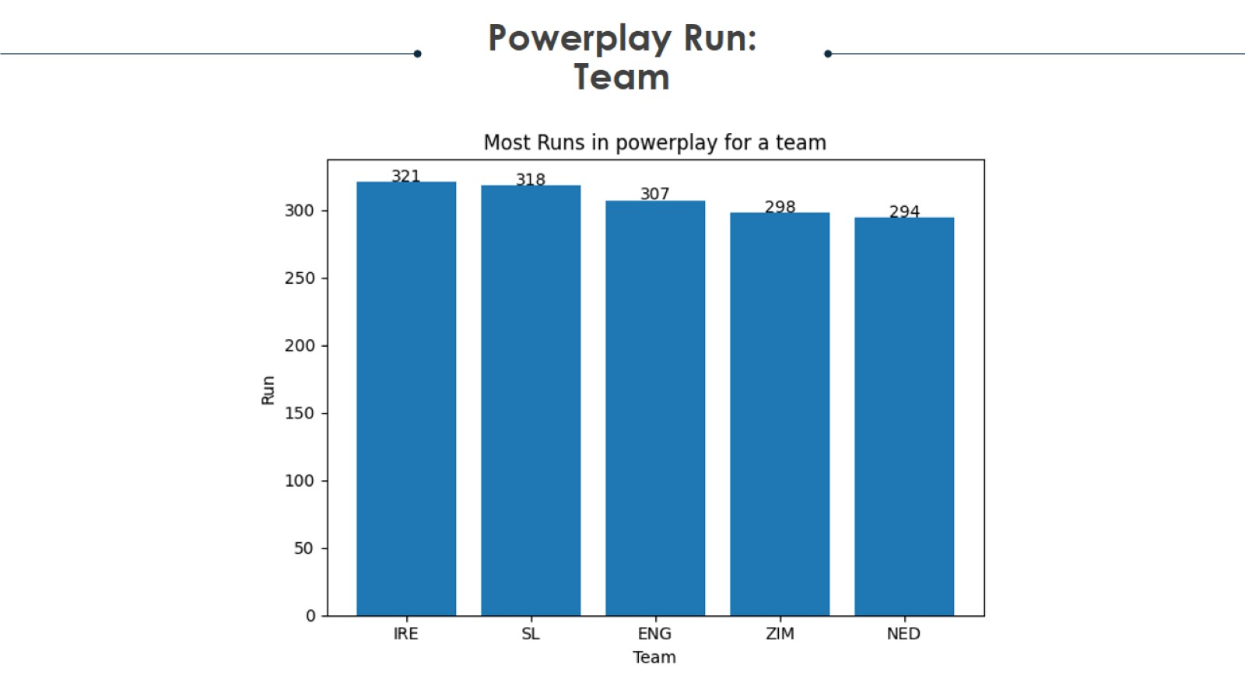
Project analysis slide 2

Slide 37
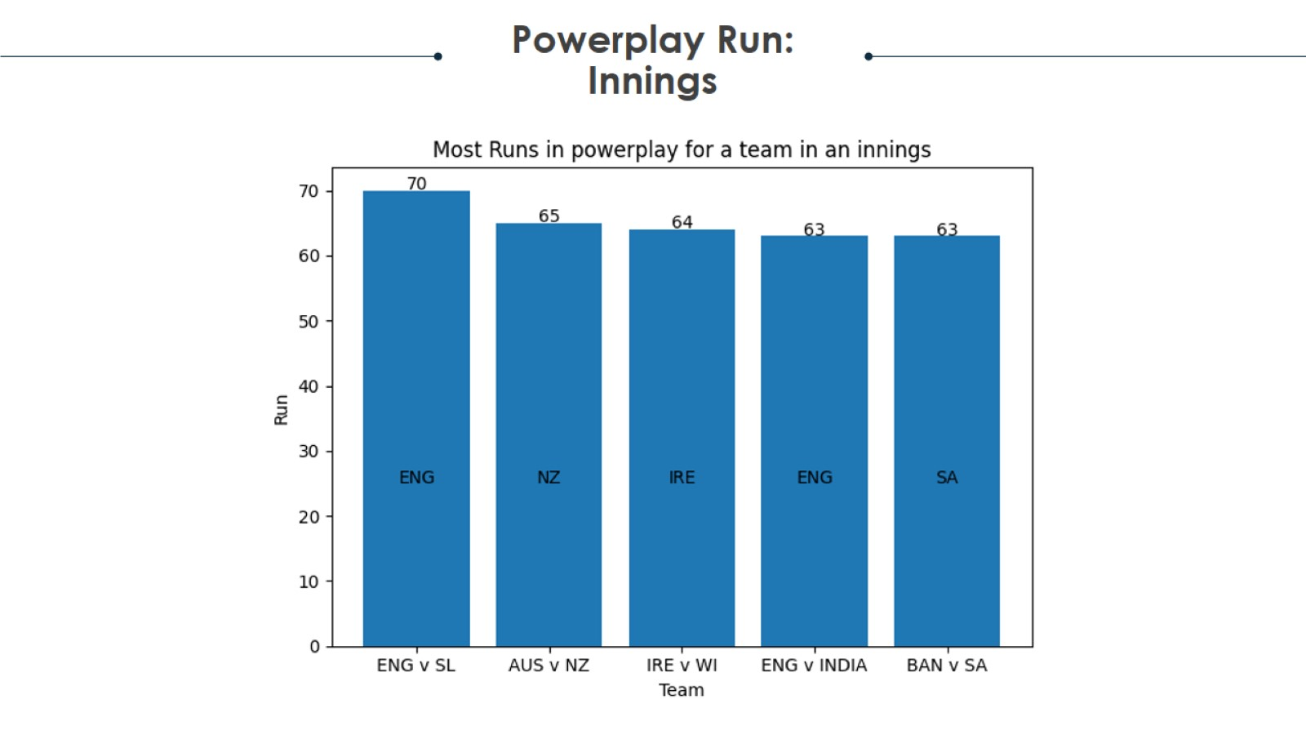
Project analysis slide 2

Slide 38
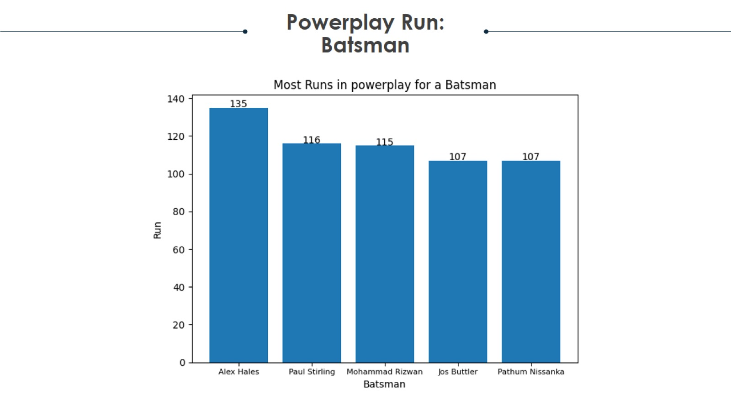
Project analysis slide 2

Slide 39

Project analysis slide 2

Slide 40
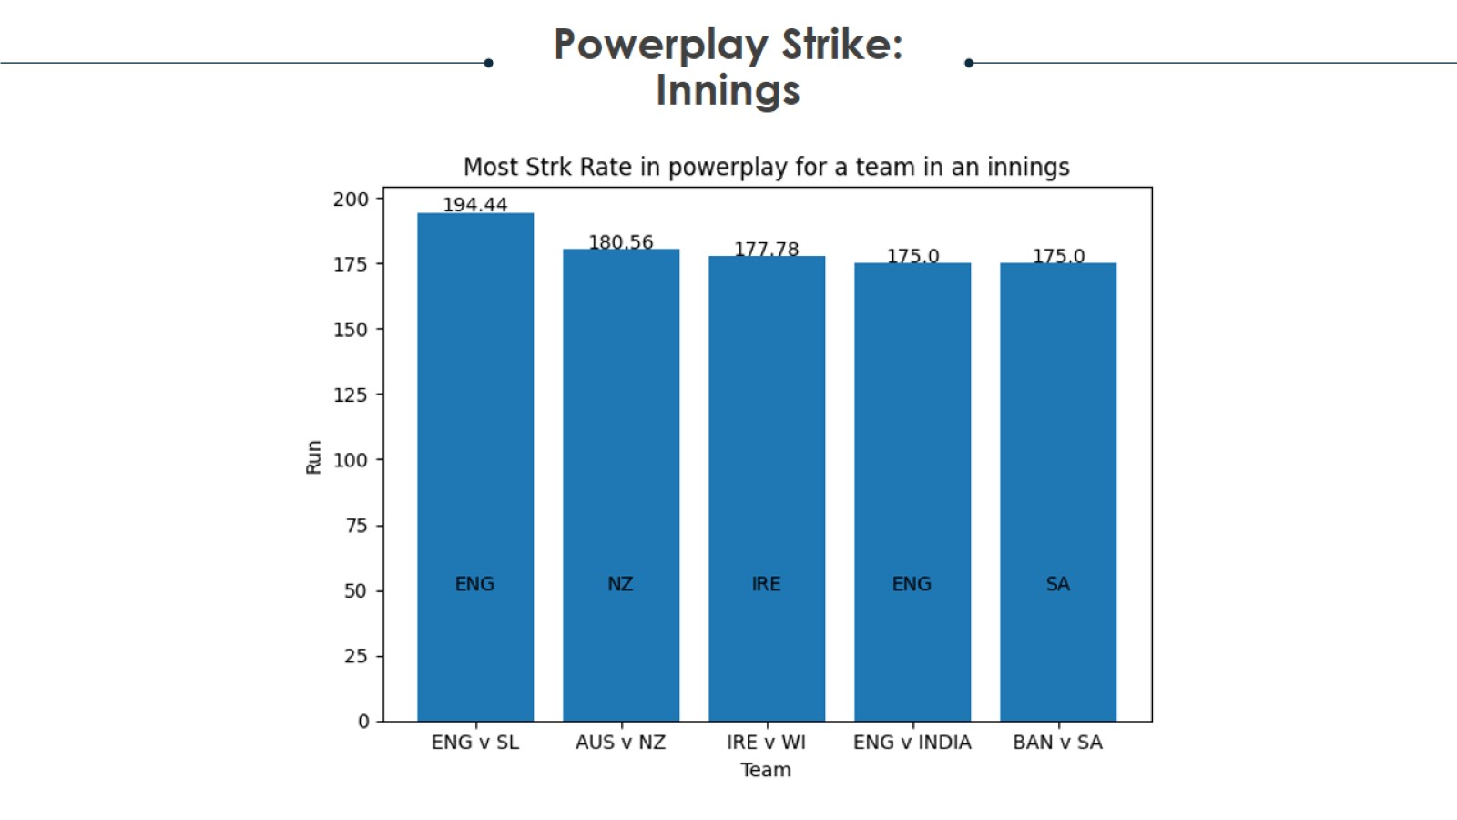
Project analysis slide 2

Slide 41
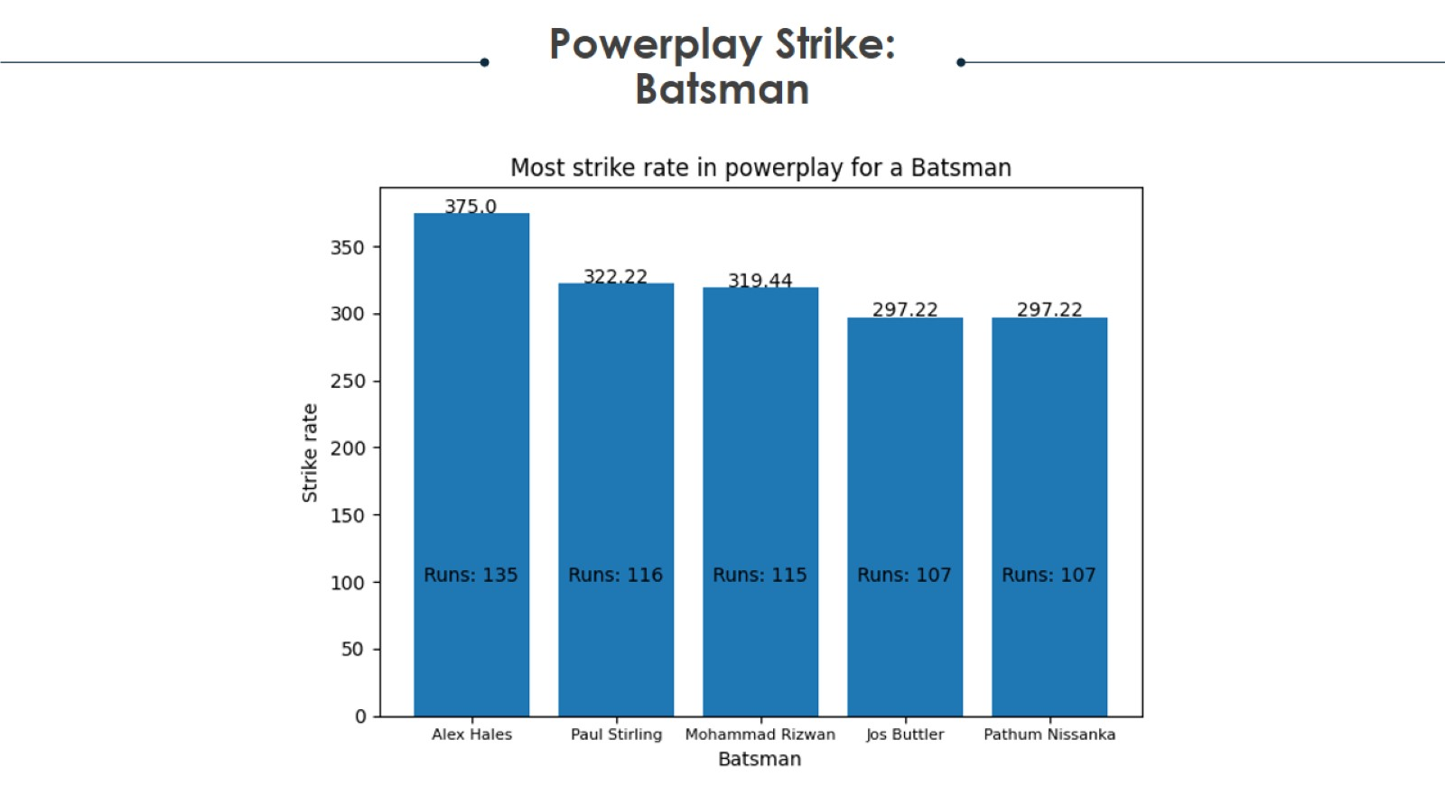
Project analysis slide 2

Slide 42
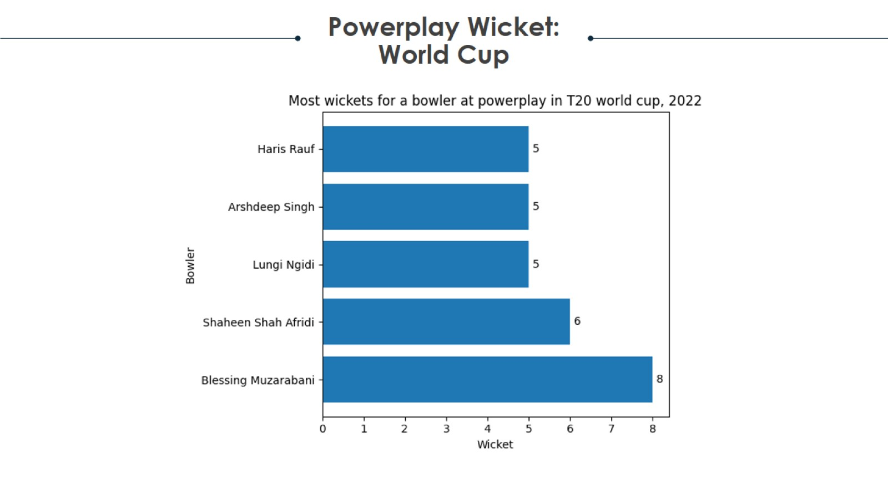
Project analysis slide 2

Slide 43
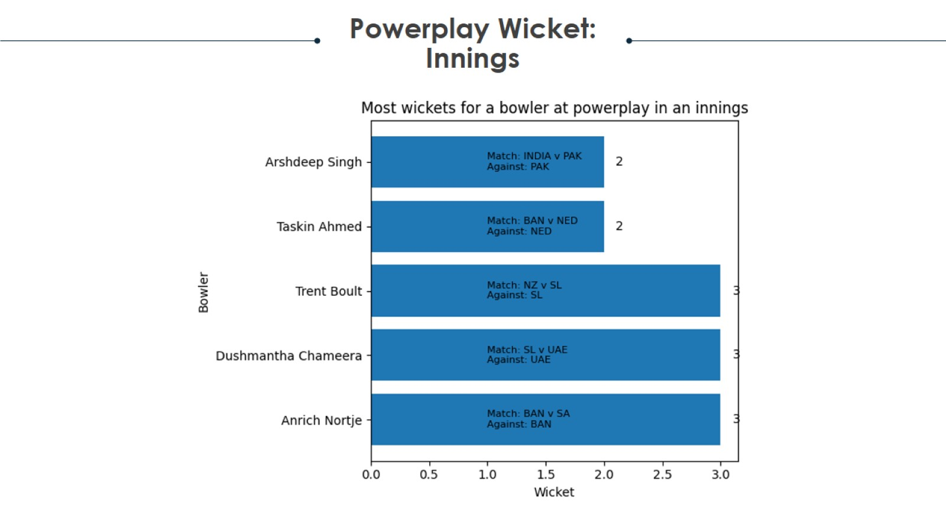
Project analysis slide 2

Slide 44
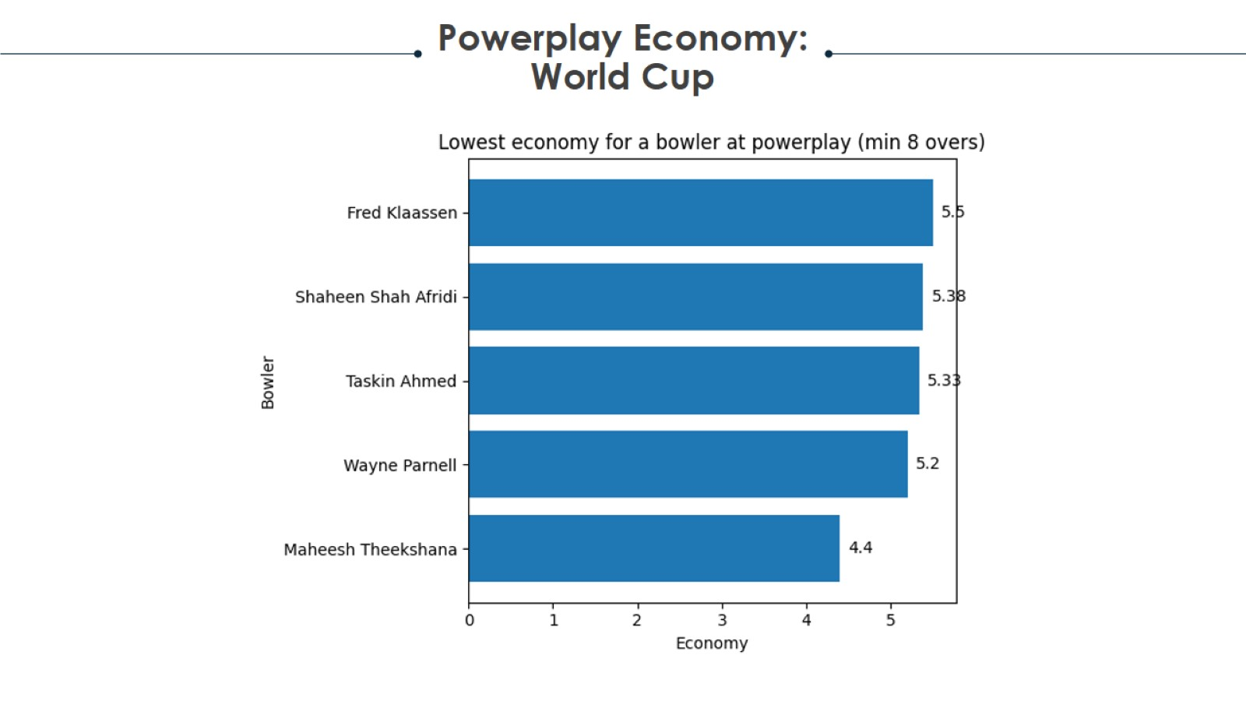
Project analysis slide 2

Slide 45
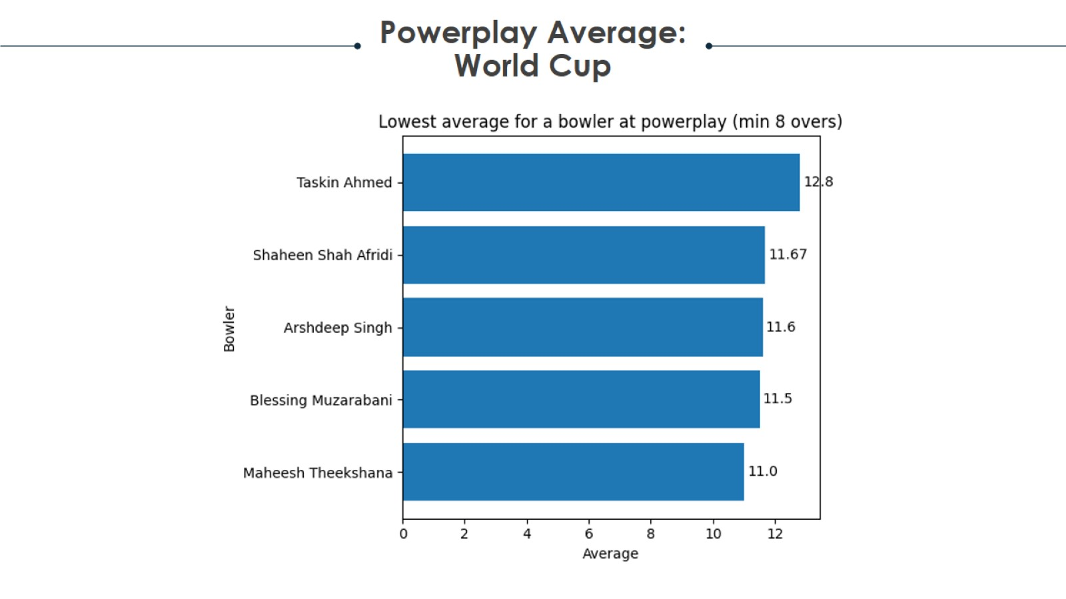
Project analysis slide 2

Slide 46
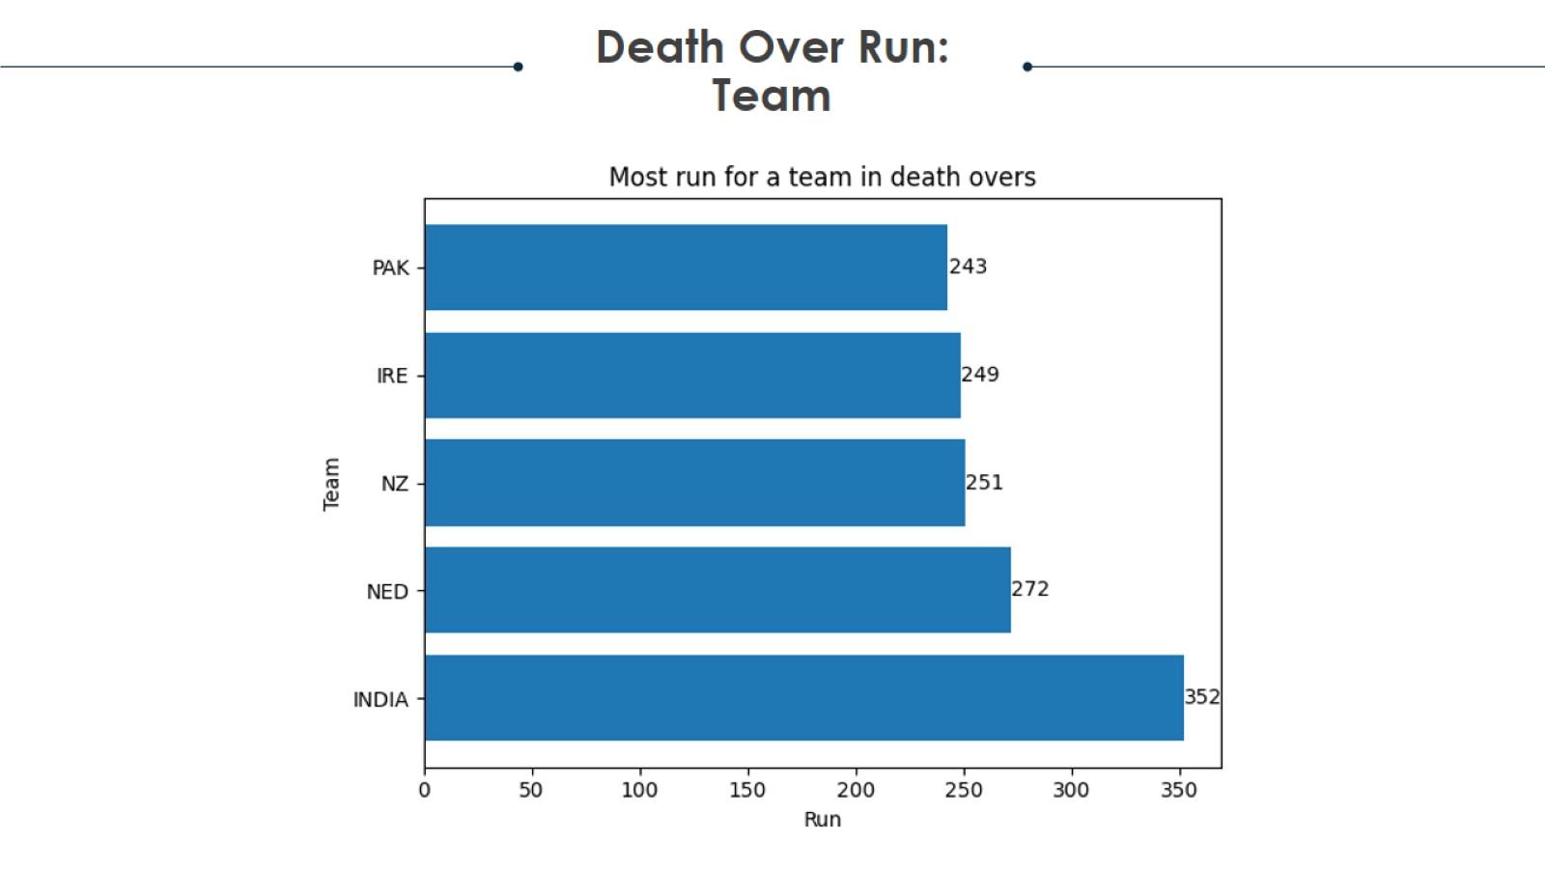
Project analysis slide 2

Slide 47

Project analysis slide 2

Slide 48
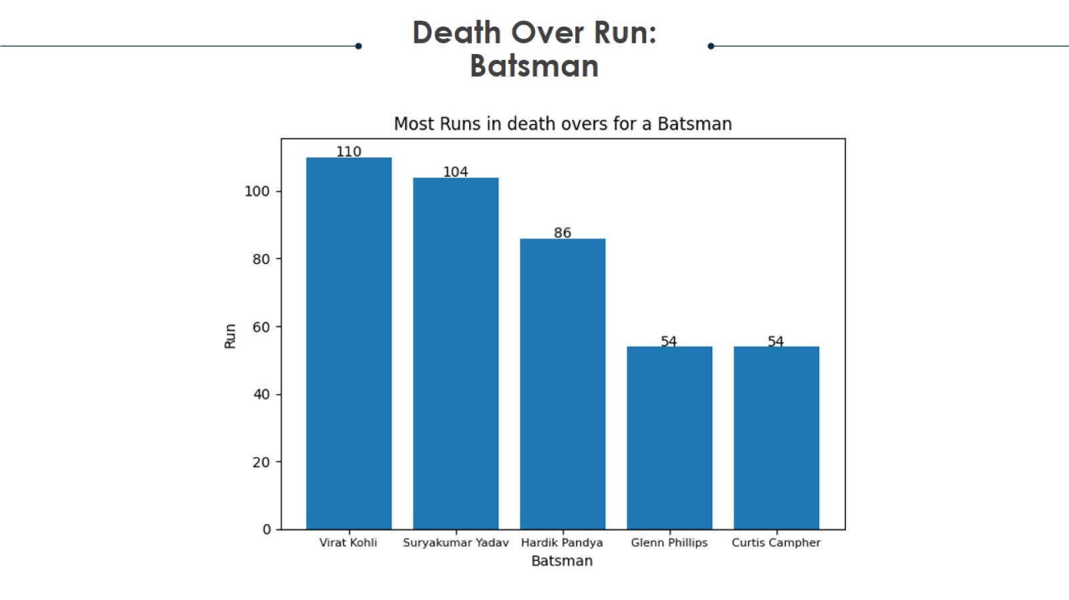
Project analysis slide 2

Slide 49
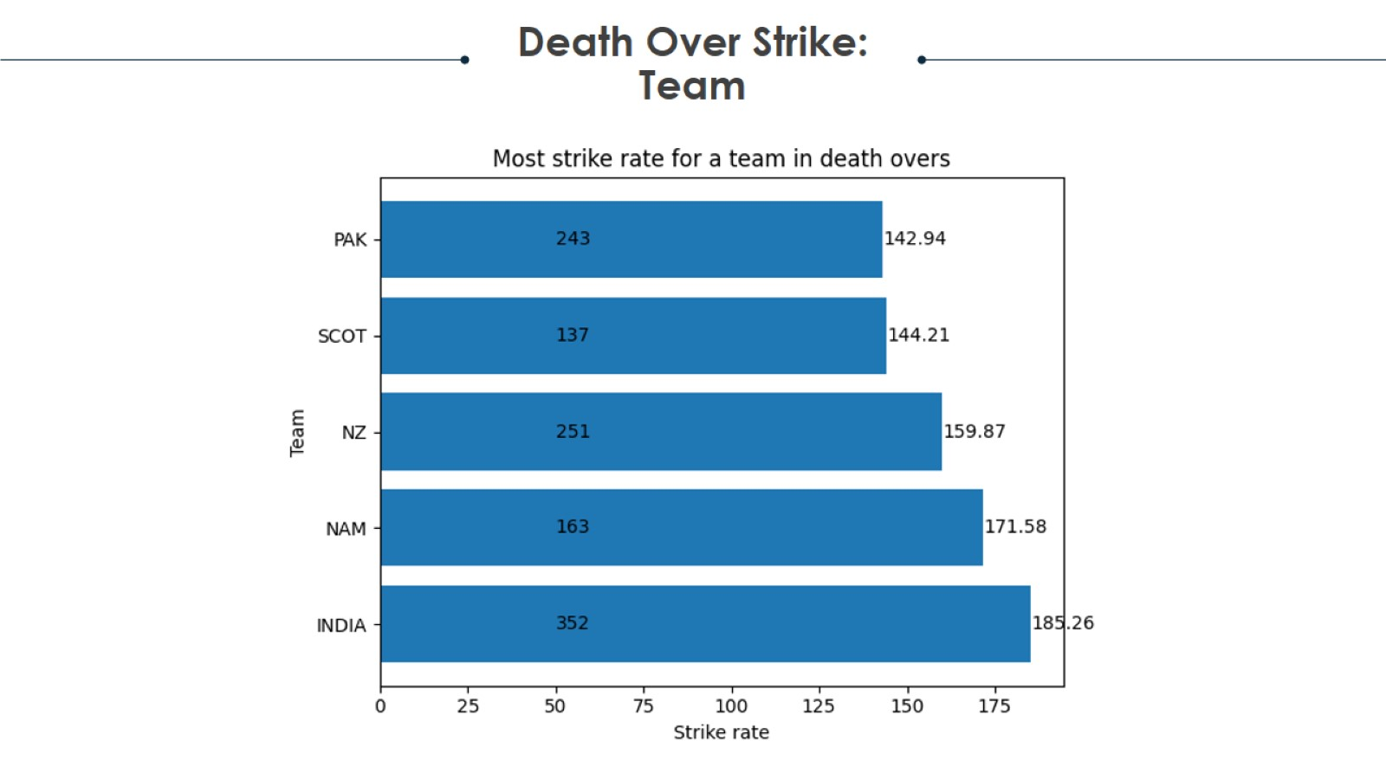
Project analysis slide 2

Slide 50
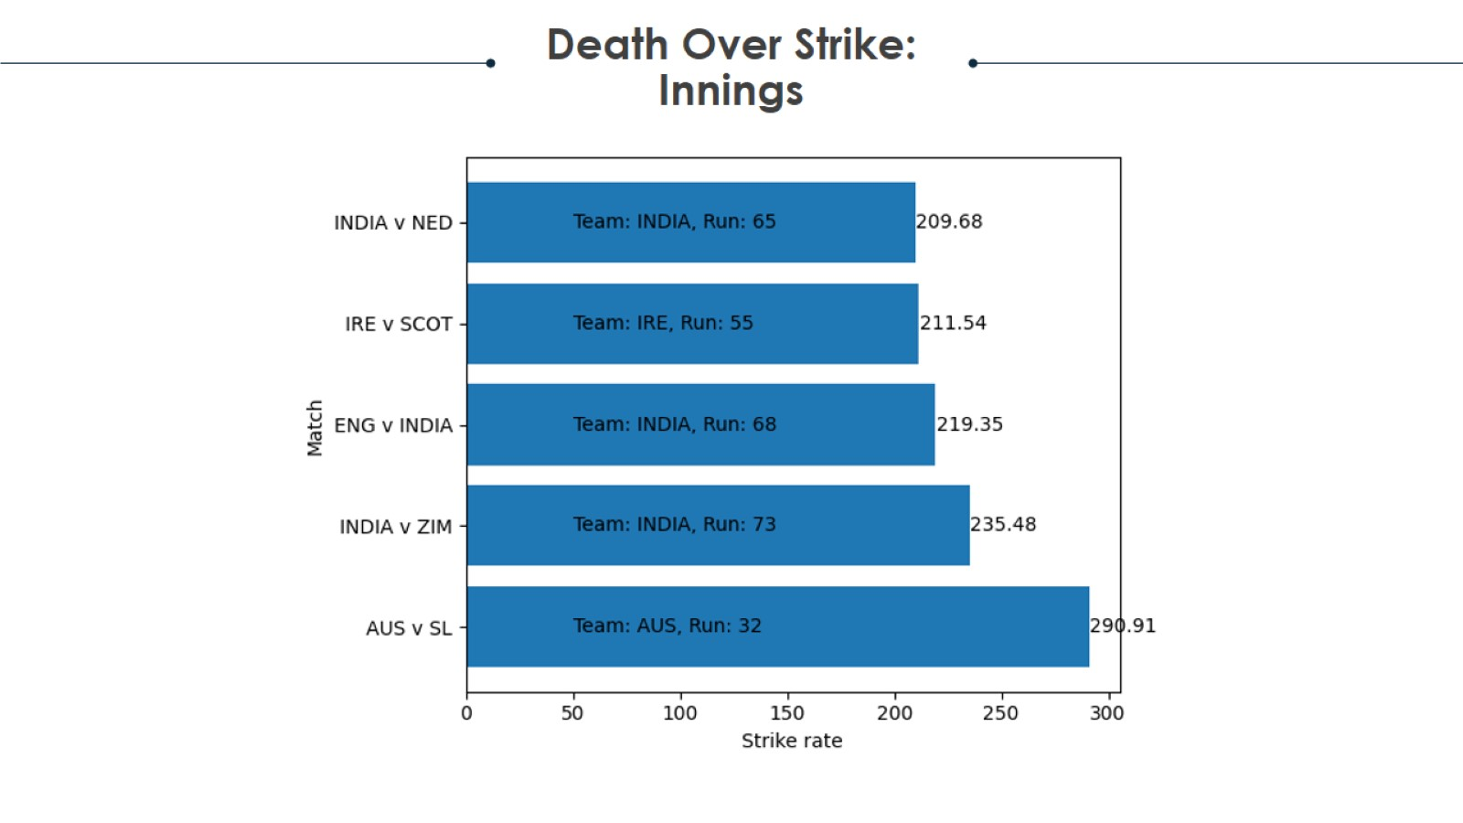
Project analysis slide 2

Slide 51
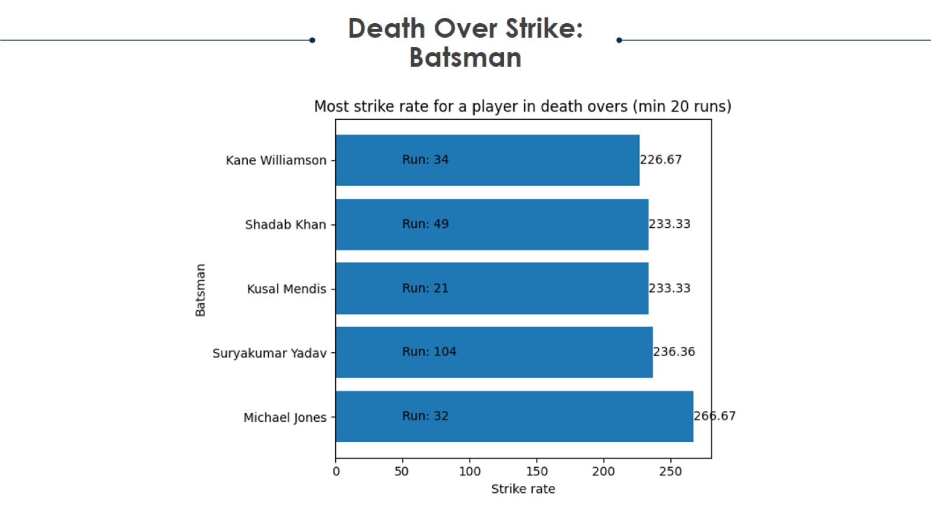
Project analysis slide 2

Slide 52
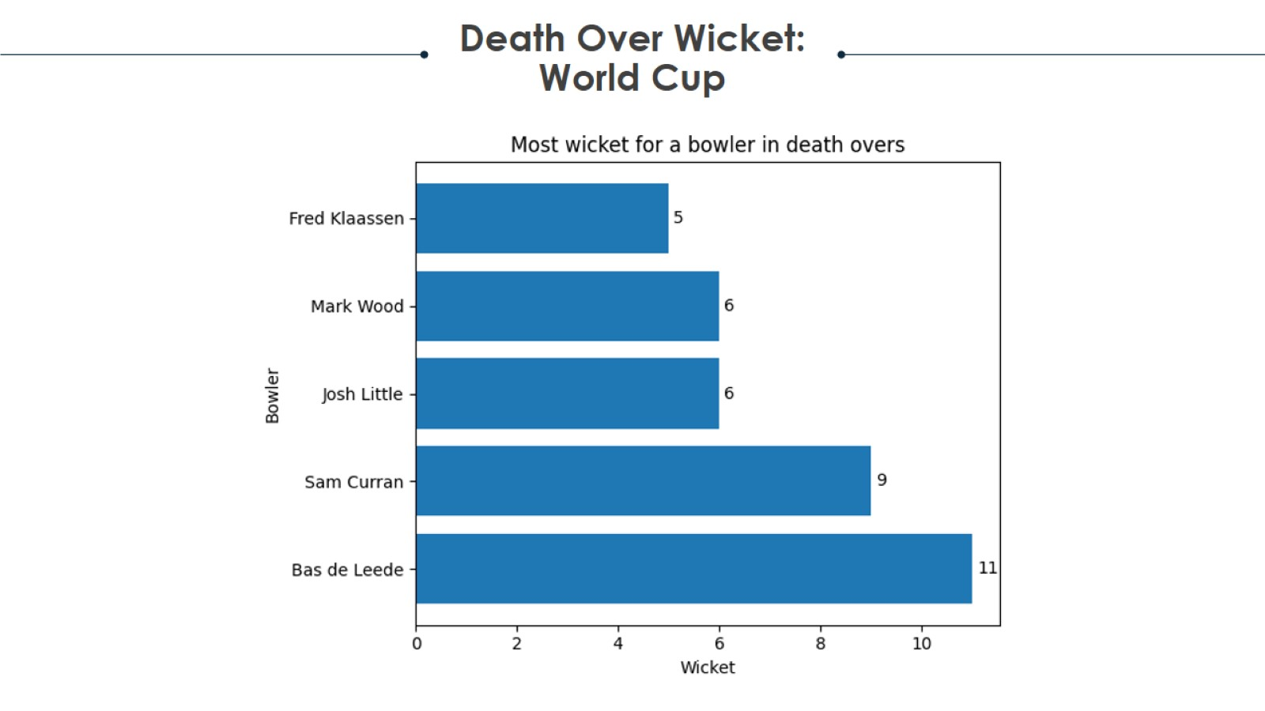
Project analysis slide 2

Slide 53

Project analysis slide 2

Slide 54
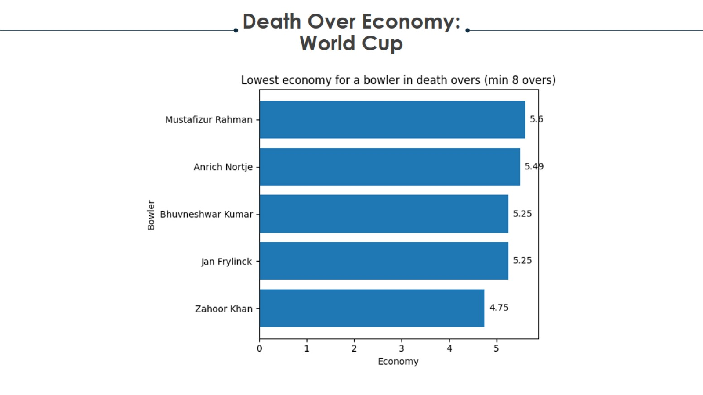
Project analysis slide 2

Slide 55

Project analysis slide 2

Slide 56


Thank You
https://cricket-t20wc2022.onrender.com/

